Slide 1


基于扩散模型的灾害
遥感图像生成技术
基于跨模态场景坐标回归的地理空间视觉定位技术
指导老师：刘仁义
答辩人：陈振源

Slide 2





汇报提纲
研究背景
研究内容
预期成果
现有进展

Slide 3

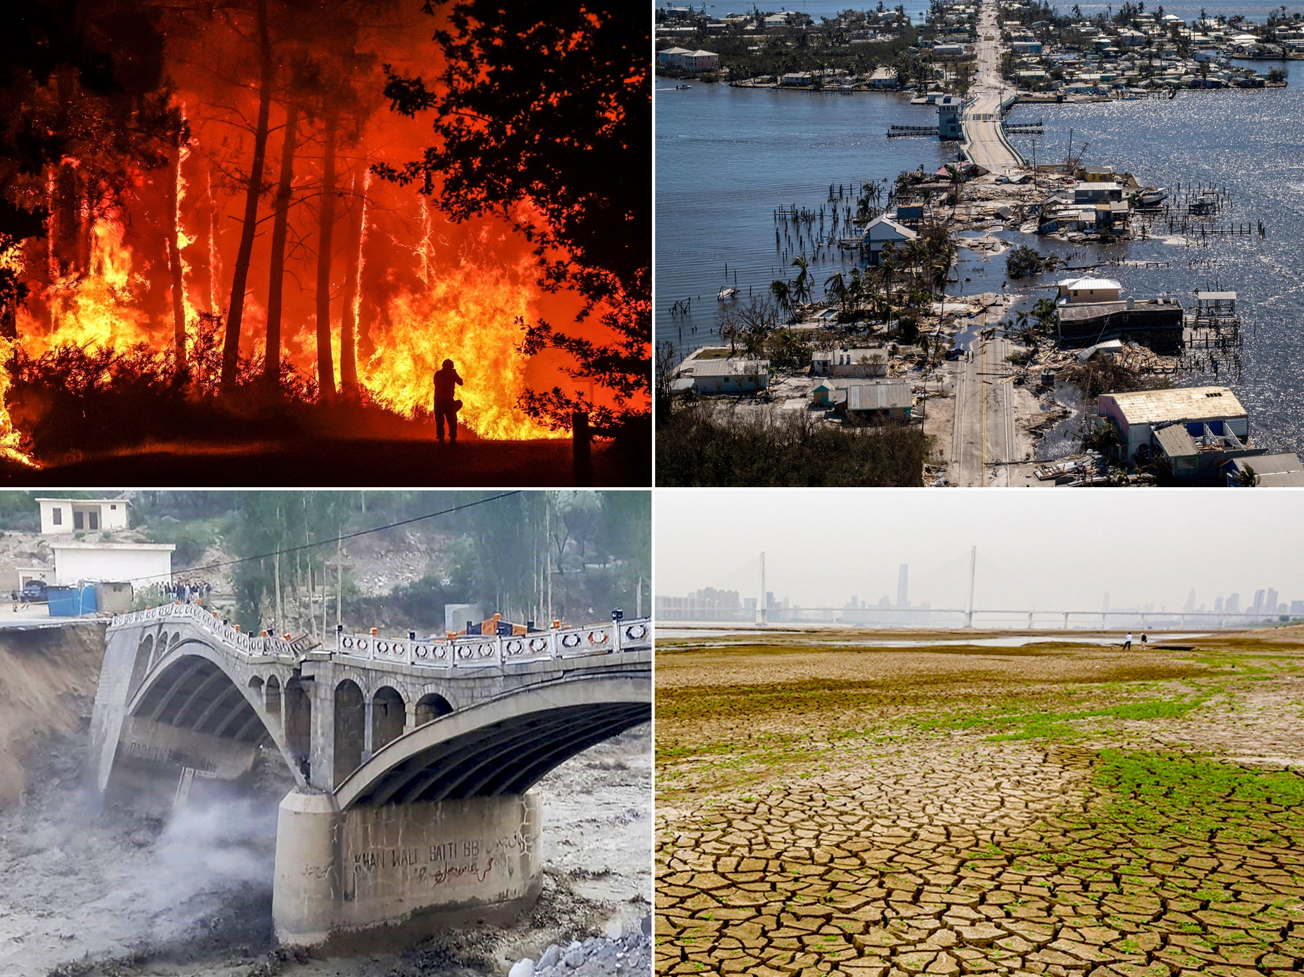
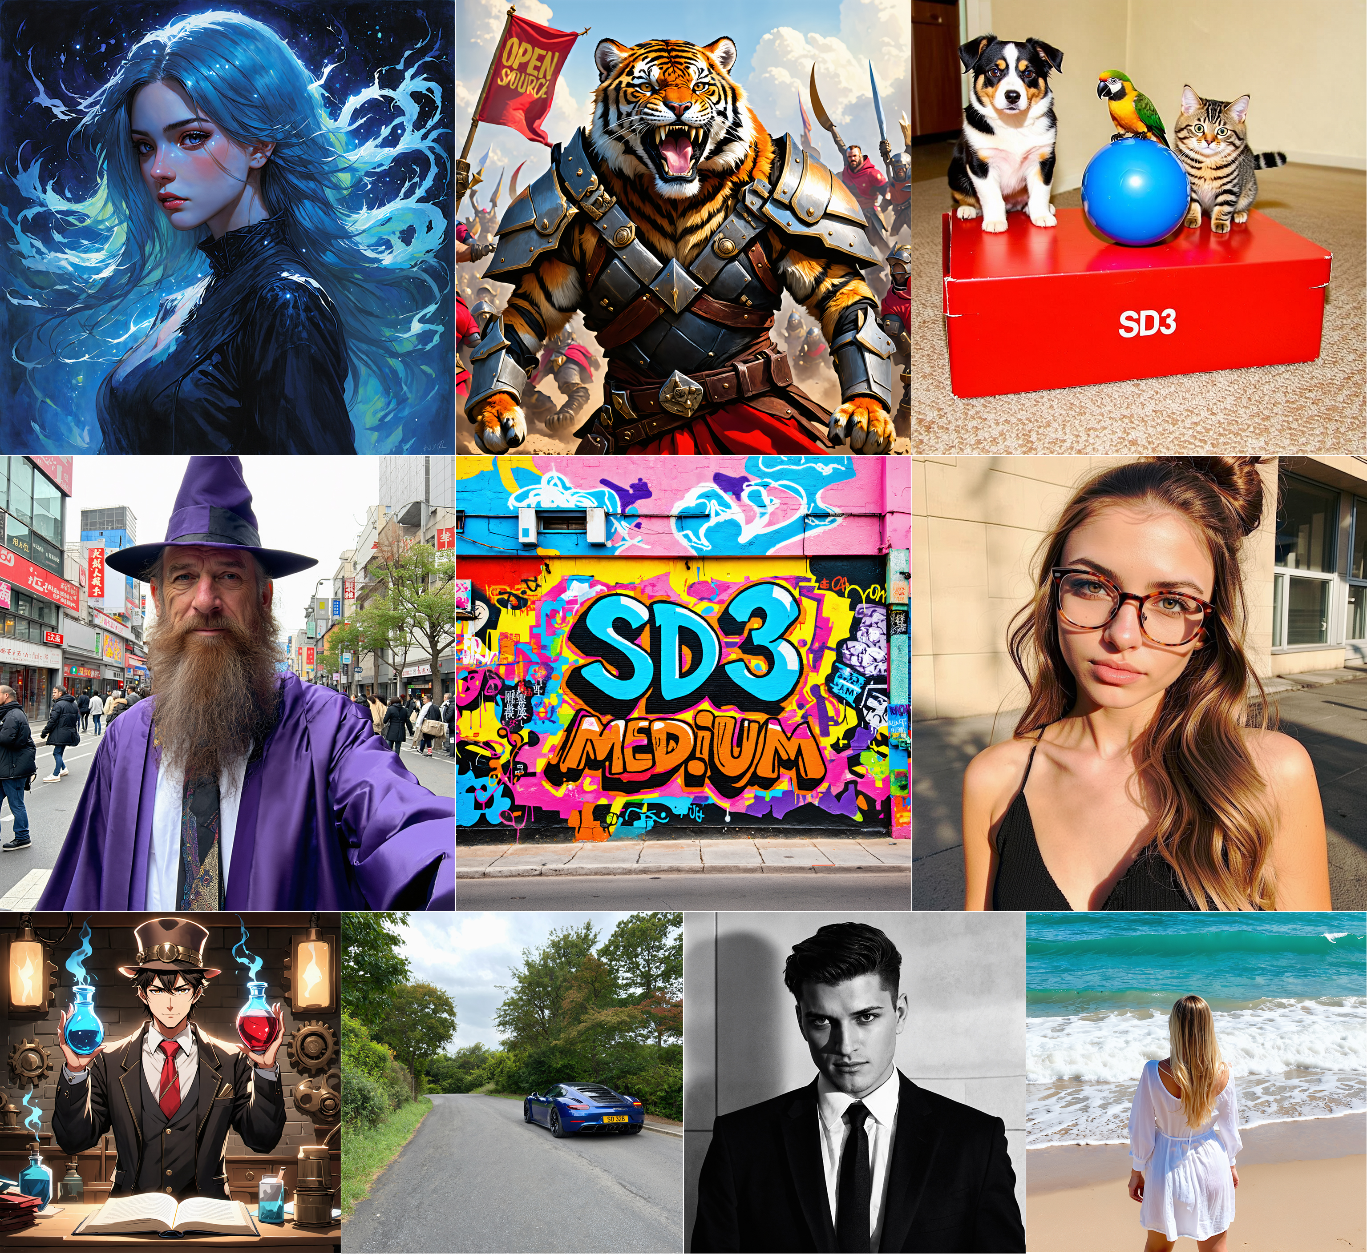
研究背景
研究内容
预期成果
现有进展
研究背景
灾害遥感图像的重要性
遥感图像在资源分配、救援路线规划、救援和恢复等人道主义援助与灾害响应任务中具有重要作用 [1]。
通过卫星影像和计算机视觉算法，可以远程和自动化地进行灾害评估，避免进行危险的现场评估 [1] 。
灾害遥感图像数据现状
灾害遥感图像获取和制作困难，存在数量稀少、时空分布不均和缺少高质量标签的问题 [2]。
扩散模型简介
扩散模型是一种基于概率的生成模型，通过逐步还原噪声图像生成高质量图像 [3-6]。
扩散模型在图像生成中的优势
高质量图像生成：扩散模型能够生成高质量的图像 [3]。
稳定性和效率：在模型训练和生成过程中具有较高的稳定性和效率 [3]。
可迁移性：通用基座模型经过少量训练能适应各种场景的图像生成 [7-9]。
世界范围内自然灾害频发
扩散模型在图像生成领域蓬勃发展

Slide 4
研究背景
研究内容
预期成果
现有进展
研究内容
文本描述：卫星影像显示，洪水泛滥，河流水位暴涨，淹没了房屋、道路和农田。整个地区被洪水覆盖，只能看到屋顶和树冠。救援人员正在紧急展开救援和物资运送。
元数据：【位置】（30°N，120°E），【时间】2020/7/10，【分辨率】0.35m
一、图像生成
GFM4D
灾前
灾后
二、受灾模拟
三、图像恢复
（生成）灾后
（生成）灾前
GFM4D是一个生成式模型，可以支持多种形式的输入，生成高质量的可靠的灾害卫星影像。
(Satellite Image Credits: SpaceNet 8 [10])
本研究拟基于扩散模型架构构建GFM4D模型，一个专职于灾害遥感图像的生成基础模型。
GFM4D模型具备文生图和图生图能力，既可以基于文本描述信息和元数据信息合成灾害遥感图像，也支持对已有的灾前（灾后）影像进行灾害场景的受灾模拟（图像恢复）。
我们通过视觉质量指标和像素质量指标评估图像生成的质量。此外，我们将合成数据用于处理各类遥感场景特化模型进行继续训练，发现特化模型在其对应的下游任务上模型性能得到显著提升，进一步证实DisasterGen模型的可靠性。

Slide 5
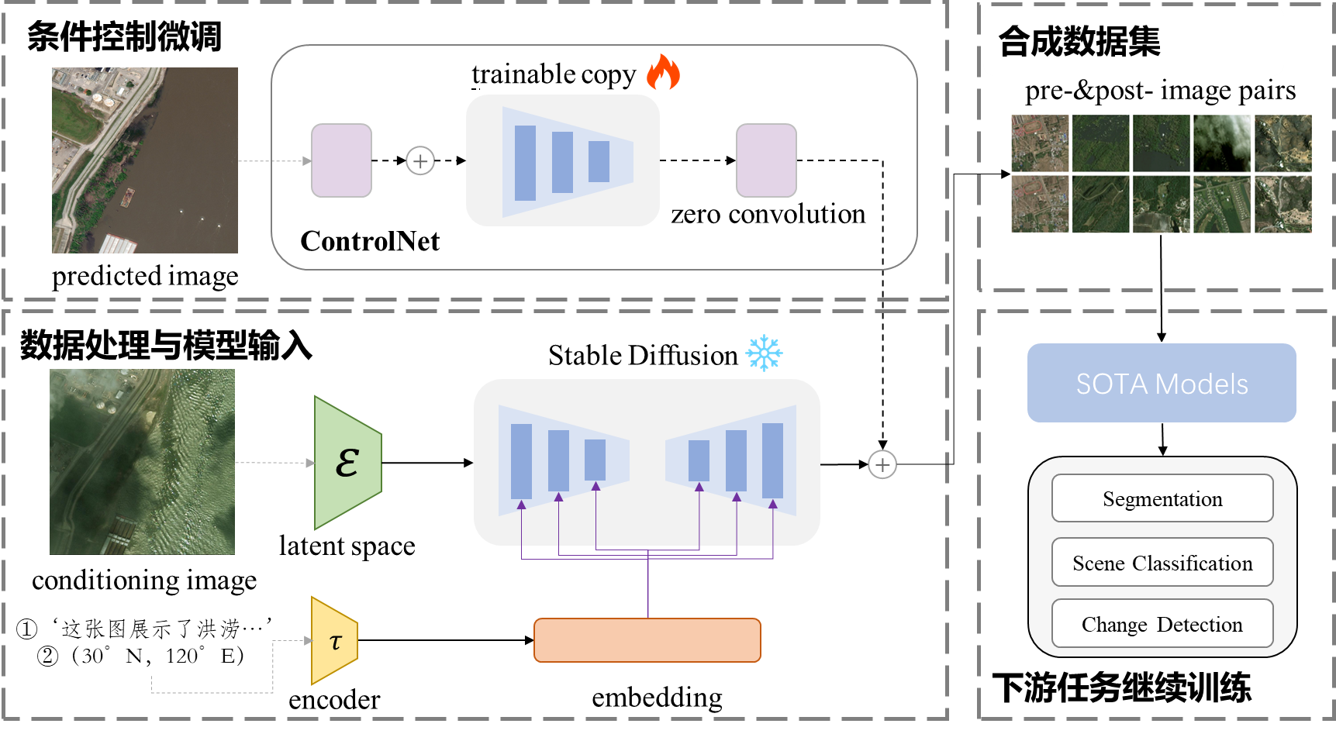
模型架构

Slide 6
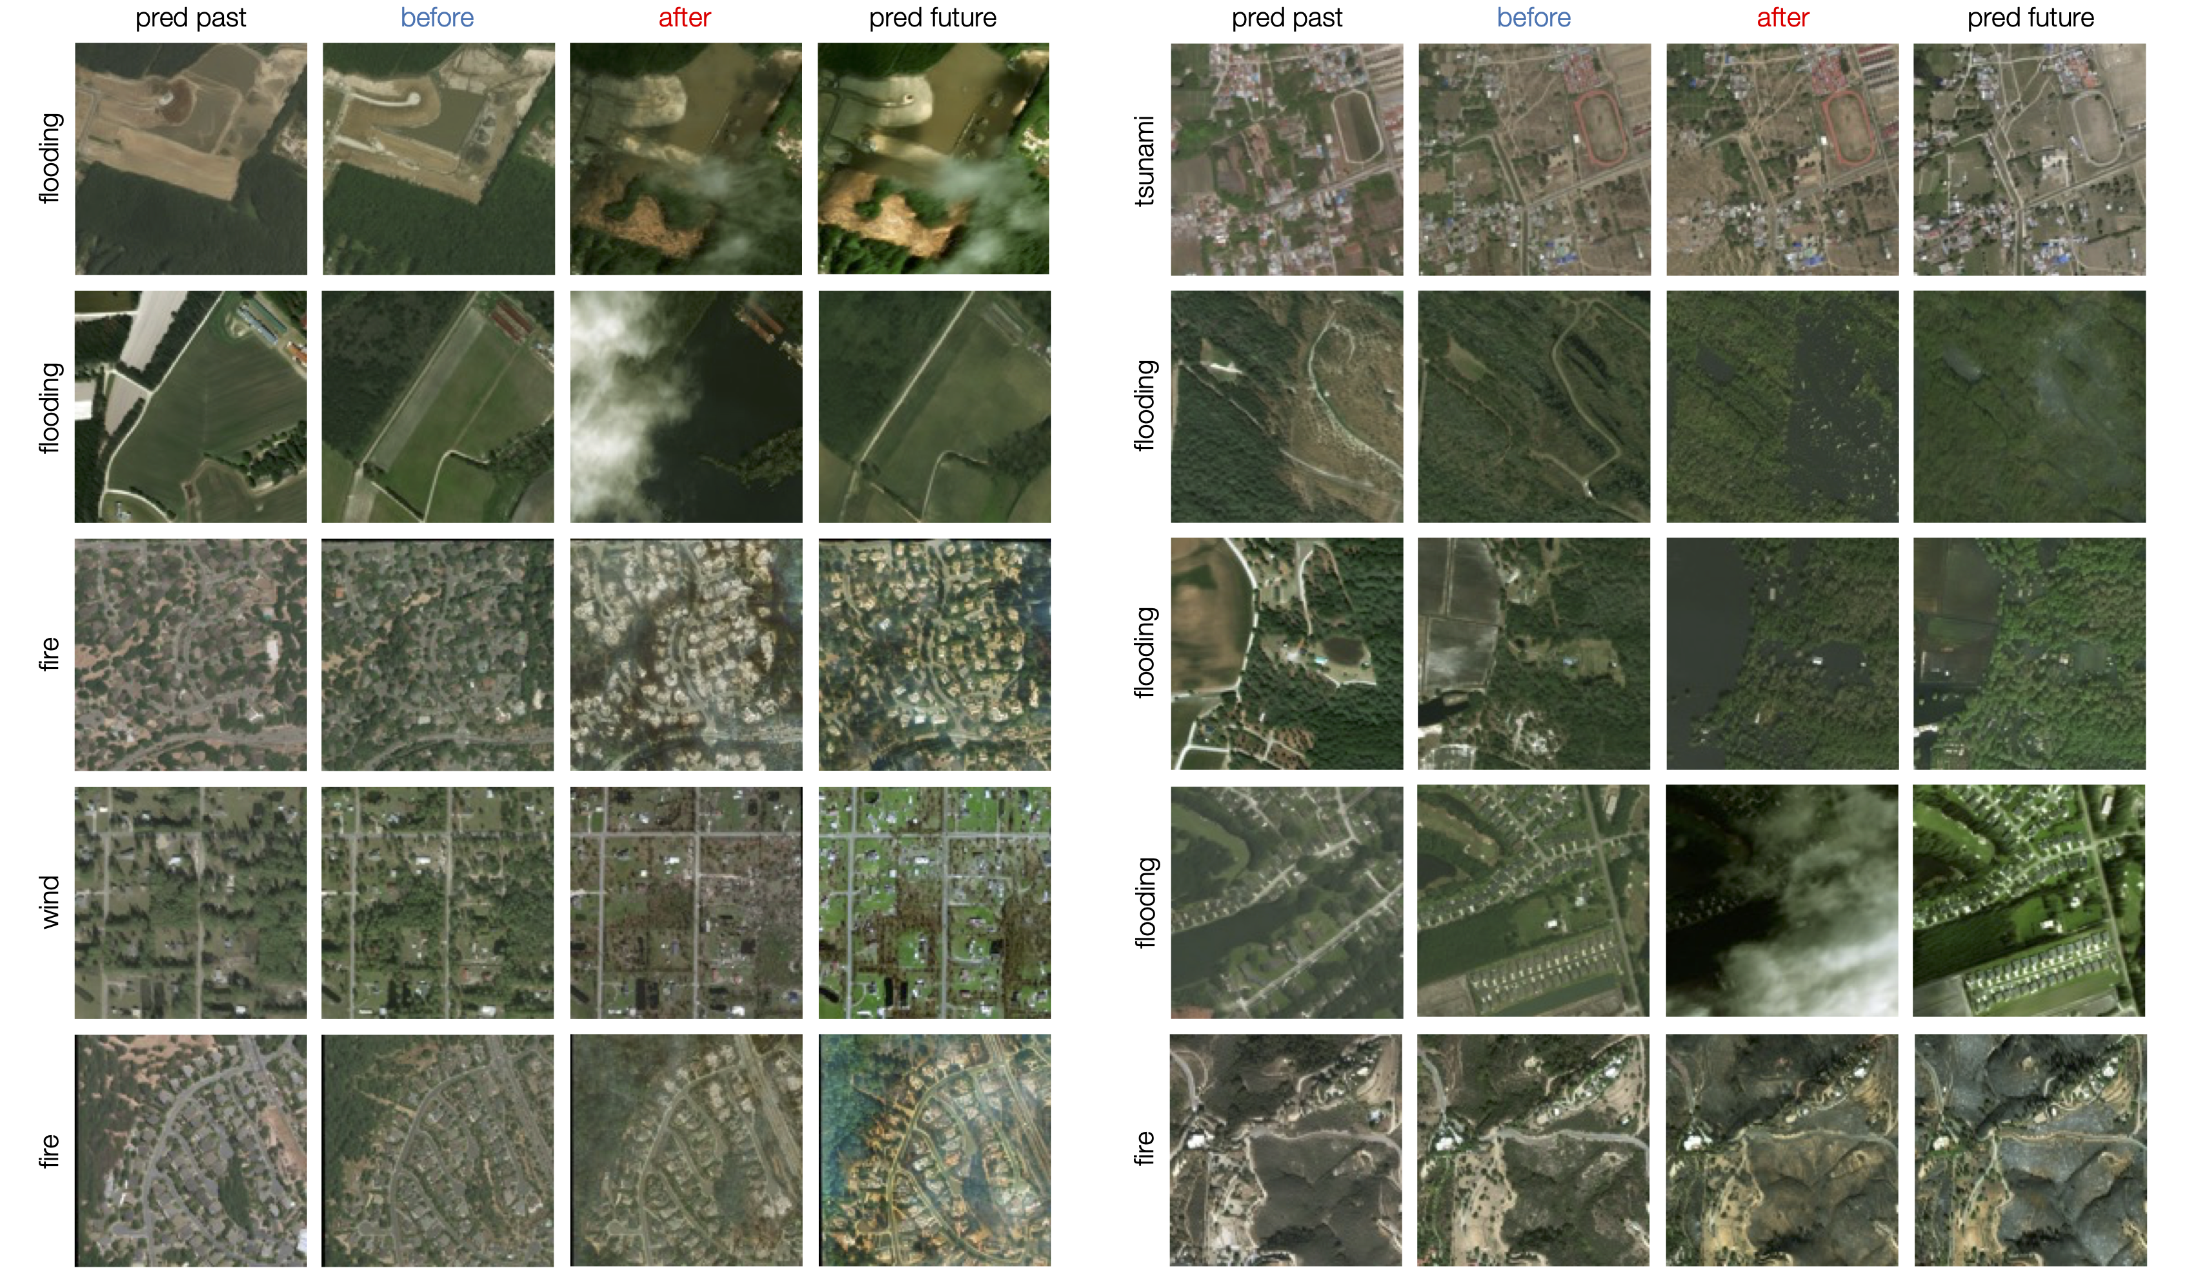
研究背景
研究内容
预期成果
现有进展
预期成果
高质量的灾害遥感图像生成
生成高分辨率、精确的灾害遥感图像
图像细节丰富，准确反映灾害情况
扩散模型的性能评估
与传统方法对比，显著提高图像质量和效率
验证模型在不同灾害场景下的适用性
实际应用价值和贡献
支持灾害监测和应急响应，提高决策及时性和准确性
提供高效的遥感图像生成工具，为相关研究提供基础数据和技术支持
灾害遥感图像生成样例
(Image Credits: DiffusionSat [2])

Slide 7
研究背景
研究内容
预期成果
现有进展
现有进展
文献调研 ✔
主要参考工作：DiffusionSat [2] 、ControlNet [8] 和Stable Diffusion [3-6]
数据集收集和模型选型 ✔
训练（含评估）数据集：xBD [1]、SpaceNet 8 [10]和fMoW-temporal [11]
骨干网络：Stable Diffusion v2.1 [6] + ControlNet [8]
对比模型：Stable Diffusion v2.1 (base) [6]、 Stable Diffusion XL (turbo) [4-5] 和Stable Diffusion 3 (medium) [3]
实验路线设计 ✔
模型架构：详见此页
风险点：由于训练数据数量或质量问题，训练过程可能会出现过拟合、模式崩塌和灾难性遗忘等问题，从而导致最终得到的模型表现较差
图像生成质量评估 ✔ 及下游任务检验 ⭕
视觉质量指标： Fréchet Inception Distance (FID) [12]、 Inception Score (IS) [13]和CLIP-score [14]
像素质量指标： SSIM [15]、PSNR、LPIPS [16]和MSE
下游任务和模型 ：待定

Slide 8
文献参考
[1] R. Gupta et al., ‘Creating xBD: A Dataset for Assessing Building Damage from Satellite Imagery’, in Proceedings of the IEEE/CVF Conference on Computer Vision and Pattern Recognition Workshops, 2019, pp. 10–17.
[2] S. Khanna et al., ‘DiffusionSat: A Generative Foundation Model for Satellite Imagery’, presented at the The Twelfth International Conference on Learning Representations, Oct. 2023.
[3] P. Esser et al., ‘Scaling Rectified Flow Transformers for High-Resolution Image Synthesis’, presented at the Forty-first International Conference on Machine Learning, Jun. 2024.
[4] A. Sauer, D. Lorenz, A. Blattmann, and R. Rombach, ‘Adversarial Diffusion Distillation’, Nov. 28, 2023, arXiv: arXiv:2311.17042.
[5] D. Podell et al., ‘SDXL: Improving Latent Diffusion Models for High-Resolution Image Synthesis’, presented at the The Twelfth International Conference on Learning Representations, Oct. 2023.
[6] R. Rombach, A. Blattmann, D. Lorenz, P. Esser, and B. Ommer, ‘High-Resolution Image Synthesis With Latent Diffusion Models’, presented at the Proceedings of the IEEE/CVF Conference on Computer Vision and Pattern Recognition, 2022, pp. 10684–10695.
[7] M. Li, T. Yang, H. Kuang, J. Wu, Z. Wang, X. Xiao, and C. Chen, "ControlNet++: Improving Conditional Controls with Efficient Consistency Feedback," in European Conference on Computer Vision, 2024.
[8] L. Zhang, A. Rao, and M. Agrawala, ‘Adding Conditional Control to Text-to-Image Diffusion Models’, in 2023 IEEE/CVF International Conference on Computer Vision (ICCV), Oct. 2023, pp. 3813–3824.
[9] S. Zhao et al., ‘Uni-ControlNet: All-in-One Control to Text-to-Image Diffusion Models’, in Neural Information Processing Systems, Curran Associates, Inc., 2023, pp. 11127–11150.
[10] R. Hänsch et al., ‘SpaceNet 8 - The Detection of Flooded Roads and Buildings’, presented at the Proceedings of the IEEE/CVF Conference on Computer Vision and Pattern Recognition, 2022, pp. 1472–1480.
[11] G. Christie, N. Fendley, J. Wilson, and R. Mukherjee, ‘Functional Map of the World’, presented at the Proceedings of the IEEE Conference on Computer Vision and Pattern Recognition, 2018, pp. 6172–6180.
[12] M. Heusel, H. Ramsauer, T. Unterthiner, B. Nessler, and S. Hochreiter, ‘GANs Trained by a Two Time-Scale Update Rule Converge to a Local Nash Equilibrium’, in Advances in Neural Information Processing Systems, Curran Associates, Inc., 2017.
[13] T. Salimans et al., ‘Improved Techniques for Training GANs’, in Advances in Neural Information Processing Systems, Curran Associates, Inc., 2016.
[14] J. Hessel, A. Holtzman, M. Forbes, R. Le Bras, and Y. Choi, ‘CLIPScore: A Reference-free Evaluation Metric for Image Captioning’, in Proceedings of the 2021 Conference on Empirical Methods in Natural Language Processing, M.-F. Moens, X. Huang, L. Specia, and S. W. Yih, Eds., Online and Punta Cana, Dominican Republic: Association for Computational Linguistics, Nov. 2021, pp. 7514–7528.
[15] Z. Wang, A. C. Bovik, H. R. Sheikh, and E. P. Simoncelli, ‘Image quality assessment: from error visibility to structural similarity’, IEEE Transactions on Image Processing, vol. 13, no. 4, pp. 600–612, Apr. 2004.
[16] R. Zhang, P. Isola, A. A. Efros, E. Shechtman, and O. Wang, ‘The Unreasonable Effectiveness of Deep Features as a Perceptual Metric’, presented at the Proceedings of the IEEE Conference on Computer Vision and Pattern Recognition, 2018, pp. 586–595.

Slide 9
恳请各位老师批评指正

Slide 10
Appendix
Model Architecture
Spatial Conditioning on Diffusion Model
Introduction to DiffusionSat
Introduction to Stable Diffusion

Slide 11
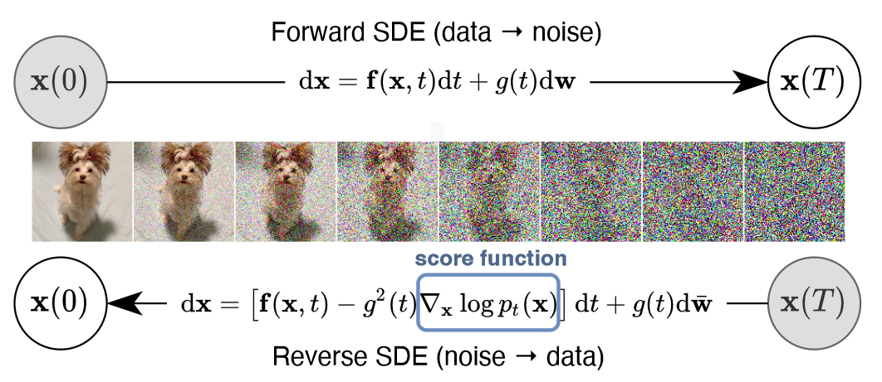
扩散模型天生缺少对空间约束提示词的理解
经典的扩散模型的图像生成的过程是每个像素同时进行去噪，不存在空间约束信息
[1] R. Rombach, A. Blattmann, D. Lorenz, P. Esser, and B. Ommer, ‘High-Resolution Image Synthesis With Latent Diffusion Models’, presented at the Proceedings of the IEEE/CVF Conference on Computer Vision and Pattern Recognition, 2022, pp. 10684–10695.

Slide 12
空间约束能力训练：前瞻
使以Stable Diffusion为首text-to-image模型获得空间约束能力，最简单的方法是直接对模型本身进行继续训练或者直接微调, 然而基座扩散模型(Stable Diffusion)的预训练数据集数量 （e.g. LAION-5B）远大于微调数据集(~100K)，直接微调往往导致过拟合、灾难性遗忘和模式崩塌的问题，因此设置精致的策略十分必要[2]。
Fine-tuning Strategies for Diffusion Models [2]
1. HyperNetwork
Function: Trains a small recurrent neural network to influence the weights of a larger one.
Applications: Image generation with GANs and Stable Diffusion to alter artistic styles.
2. Adapter Methods
NLP Use: Embeds new module layers in pretrained transformers.
Computer Vision Use: Incremental learning and domain adaptation, often with CLIP.
Success: Vision transformers and ViT-Adapter.
3. Additive Learning
Mechanism: Freezes original model weights, adds new parameters through: Learned weight masks, pruning, hard attention
4. Side-Tuning
Approach: Adds a side branch model to learn extra functionality.
Blending: Linearly blends outputs of a frozen model and the new network with a predefined weight schedule.
5. Low-Rank Adaptation (LoRA)
Concept: Learns parameter offsets using low-rank matrices.
Purpose: Prevents catastrophic forgetting by leveraging low intrinsic dimension subspaces.
6. Zero-Initialized Layers
Usage: ControlNet.
[1] R. Rombach, A. Blattmann, D. Lorenz, P. Esser, and B. Ommer, ‘High-Resolution Image Synthesis With Latent Diffusion Models’, presented at the Proceedings of the IEEE/CVF Conference on Computer Vision and Pattern Recognition, 2022, pp. 10684–10695.
[2] L. Zhang, A. Rao, and M. Agrawala, ‘Adding Conditional Control to Text-to-Image Diffusion Models’, in 2023 IEEE/CVF International Conference on Computer Vision (ICCV), Oct. 2023, pp. 3813–3824. doi: 10.1109/ICCV51070.2023.00355.

Slide 13
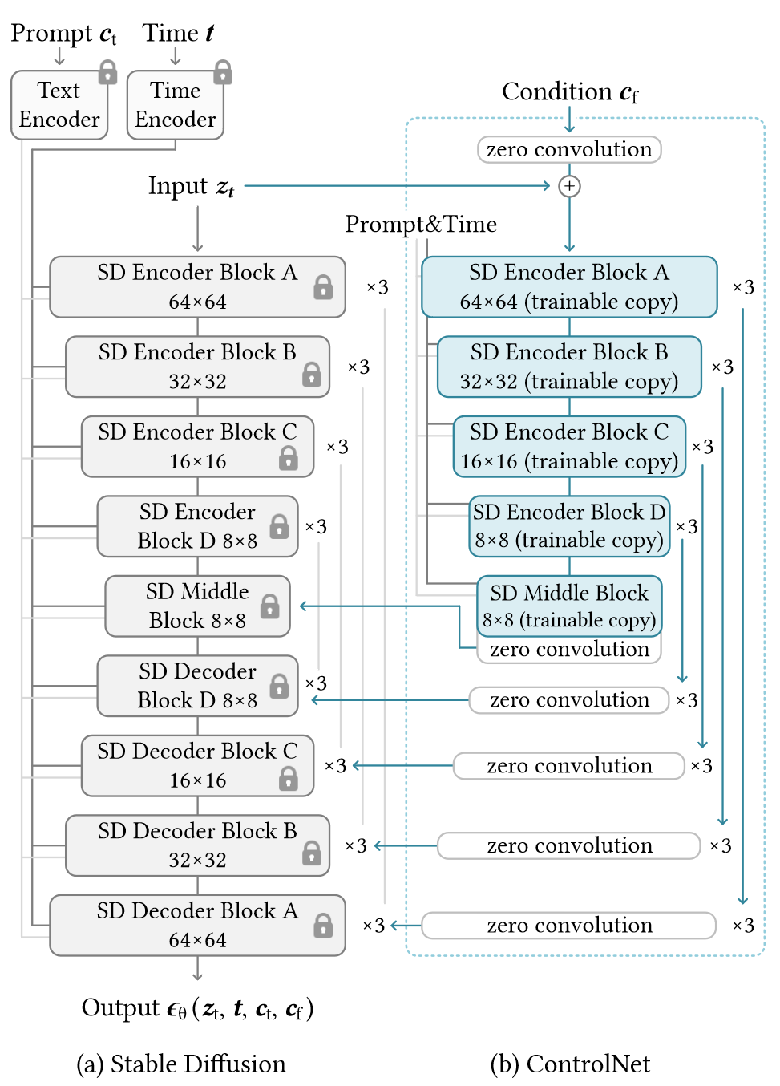
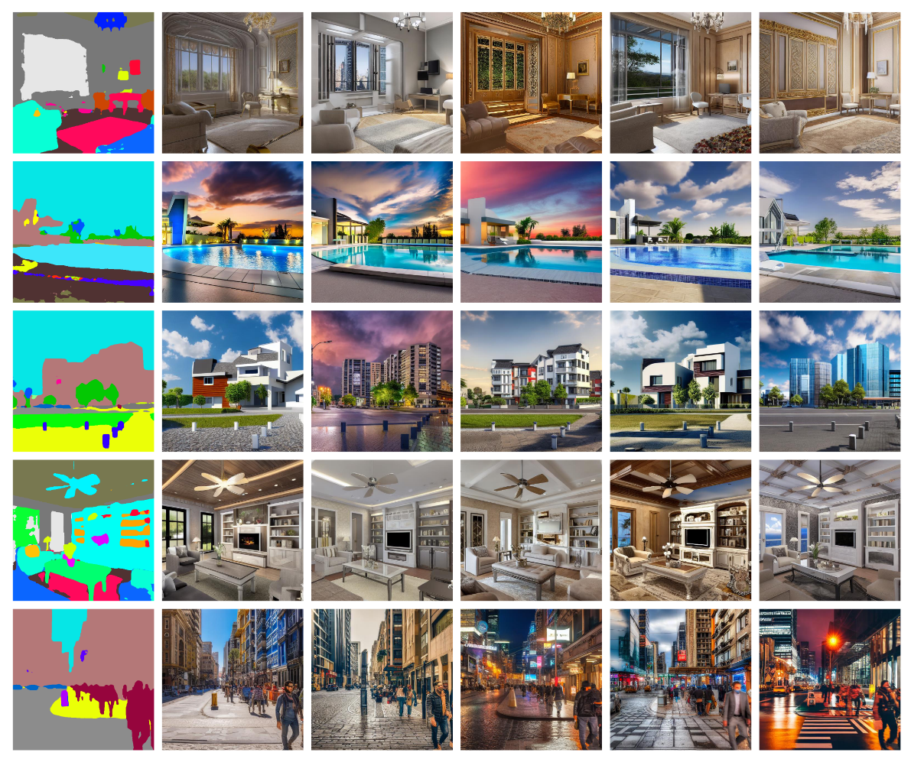
空间约束（一）：SD+ControlNet
Segmentation Map as Spatial Condition with fancy output
ControlNet冻结Stable Diffusion的权重，同时复制Stable Diffusion的Encoder权重在此基础上进行训练，通过ControlNet网络实现空间约束能力 [2]
[2] L. Zhang, A. Rao, and M. Agrawala, ‘Adding Conditional Control to Text-to-Image Diffusion Models’, in 2023 IEEE/CVF International Conference on Computer Vision (ICCV), Oct. 2023, pp. 3813–3824. doi: 10.1109/ICCV51070.2023.00355.

Slide 14
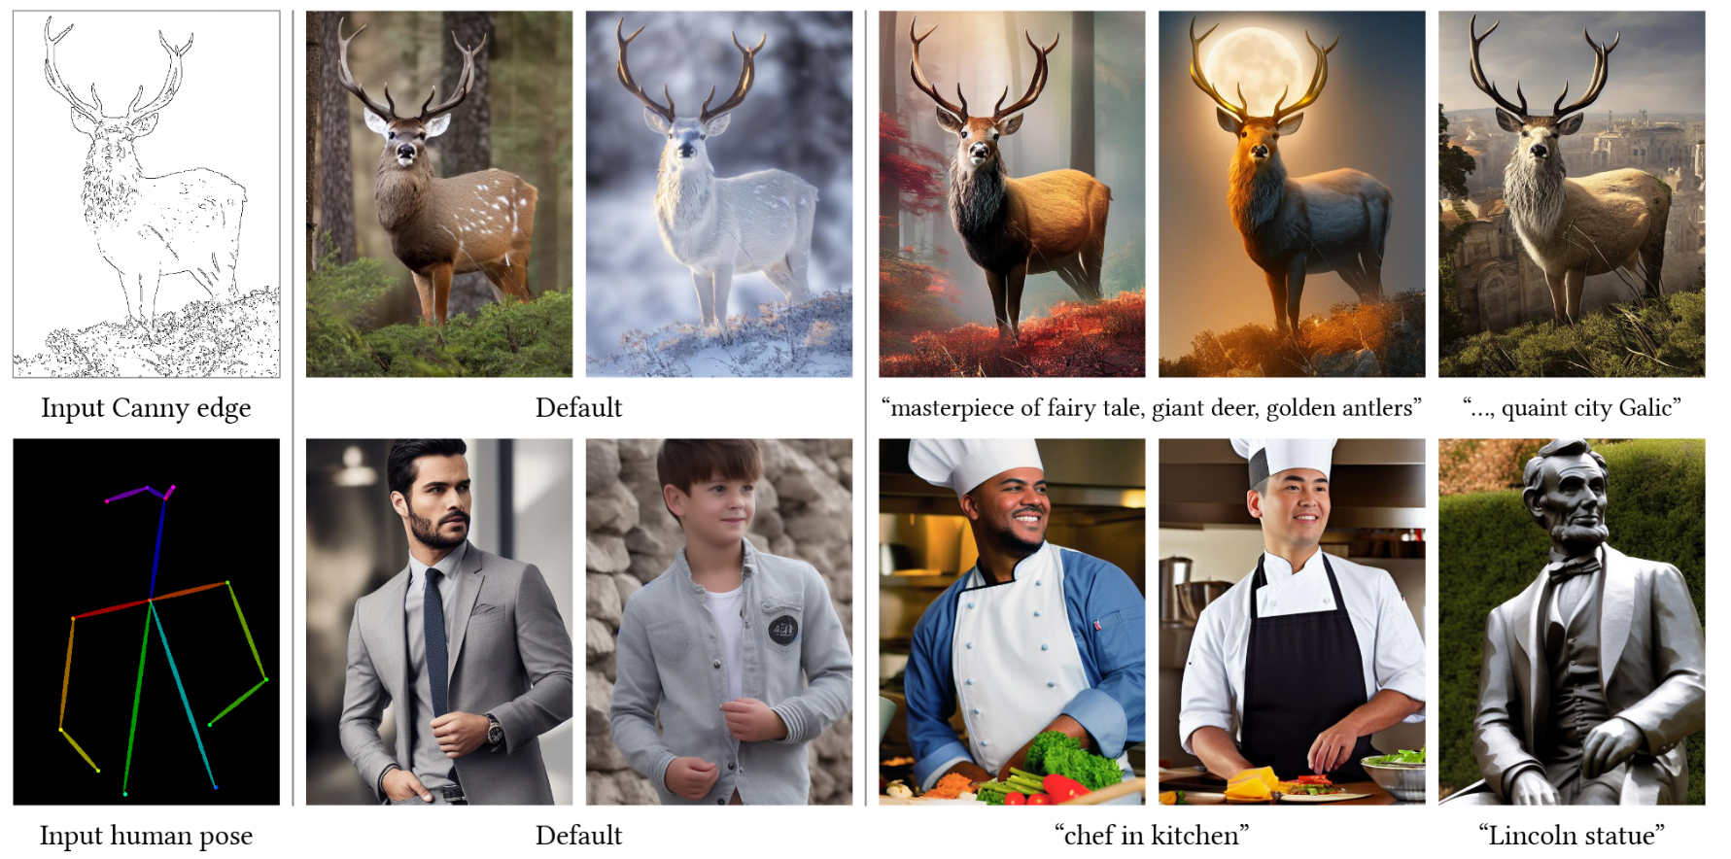
空间约束（一）：SD+ControlNet
缺陷：训练数据是一张图像文本对，不包含同一张图像的前后变化信息，仍然是一个text-to-image模型 [2]
[2] L. Zhang, A. Rao, and M. Agrawala, ‘Adding Conditional Control to Text-to-Image Diffusion Models’, in 2023 IEEE/CVF International Conference on Computer Vision (ICCV), Oct. 2023, pp. 3813–3824. doi: 10.1109/ICCV51070.2023.00355.

Slide 15
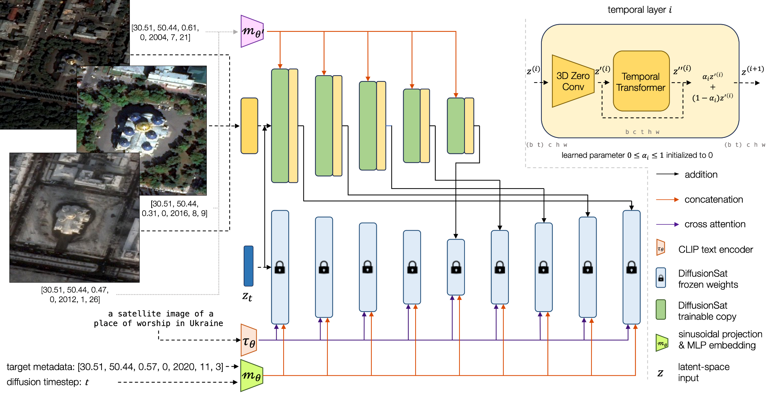
空间约束（二）：SD+3DControlNet (Temporal) → DiffusionSat
DiffusionSat使用同个地点的时序数据进行ControlNet的训练，使模型获得序列图像生成的能力
如此，参考图（如灾前图像）作为输入条件控制，可以极大程度的保持原有图像的信息 [3]
[3] S. Khanna et al., ‘DiffusionSat: A Generative Foundation Model for Satellite Imagery’, presented at the The Twelfth International Conference on Learning Representations, Oct. 2023.

Slide 16

Outline
Overview
Model Architecture
SD
SD + ControlNet
Single Image Generation
Textual Prompt + Numerical Metadata
Inverse Problems
Superresolution
Temporal Prediction
Temporal Inpainting
Temporal Sequence Generation
Implementation in Python Project
© Sakura, 2024. All rights reserved.

Slide 17
Overview
© Sakura, 2024. All rights reserved.

Slide 18
Abstract of DiffusionSat
Diffusion models have achieved state-of-the-art results on many modalities including images, speech, and video. However, existing models are not tailored to support remote sensing data, which is widely used in important applications including environmental monitoring and crop-yield prediction. Satellite images are significantly different from natural images -- they can be multi-spectral, irregularly sampled across time -- and existing diffusion models trained on images from the Web do not support them. Furthermore, remote sensing data is inherently spatio-temporal, requiring conditional generation tasks not supported by traditional methods based on captions or images. In this paper, we present DiffusionSat, to date the largest generative foundation model trained on a collection of publicly available large, high-resolution remote sensing datasets. As text-based captions are sparsely available for satellite images, we incorporate the associated metadata such as geolocation as conditioning information. Our method produces realistic samples and can be used to solve multiple generative tasks including temporal generation, superresolution given multi-spectral inputs and in-painting. Our method outperforms previous state-of-the-art methods for satellite image generation and is the first large-scale generative foundation model for satellite imagery.
扩散模型在图像、语音和视频等多种模态上取得了最先进的成果。然而，现有模型并不支持在重要应用如环境监测和作物产量预测中广泛使用的遥感数据。卫星图像与自然图像显著不同——它们可以是多光谱的、时间上不规则采样的。现有的扩散模型无法处理这些数据。遥感数据本质上是时空数据，需要传统基于字幕或图像的方法不支持的条件生成任务。本文提出了DiffusionSat，这是迄今为止基于公共大规模高分辨率遥感数据集训练的最大生成基础模型。由于卫星图像的文字描述稀少，我们结合了地理位置等相关元数据作为条件信息。我们的方法生成逼真的样本，可用于解决多种生成任务，包括时间生成、多光谱输入的超分辨率和修复。我们的方法在卫星图像生成方面优于现有最先进的方法，是第一个大规模的卫星图像生成基础模型。
© Sakura, 2024. All rights reserved.

Slide 19
Model Architecture
SD
SD + ControlNet
© Sakura, 2024. All rights reserved.

Slide 20
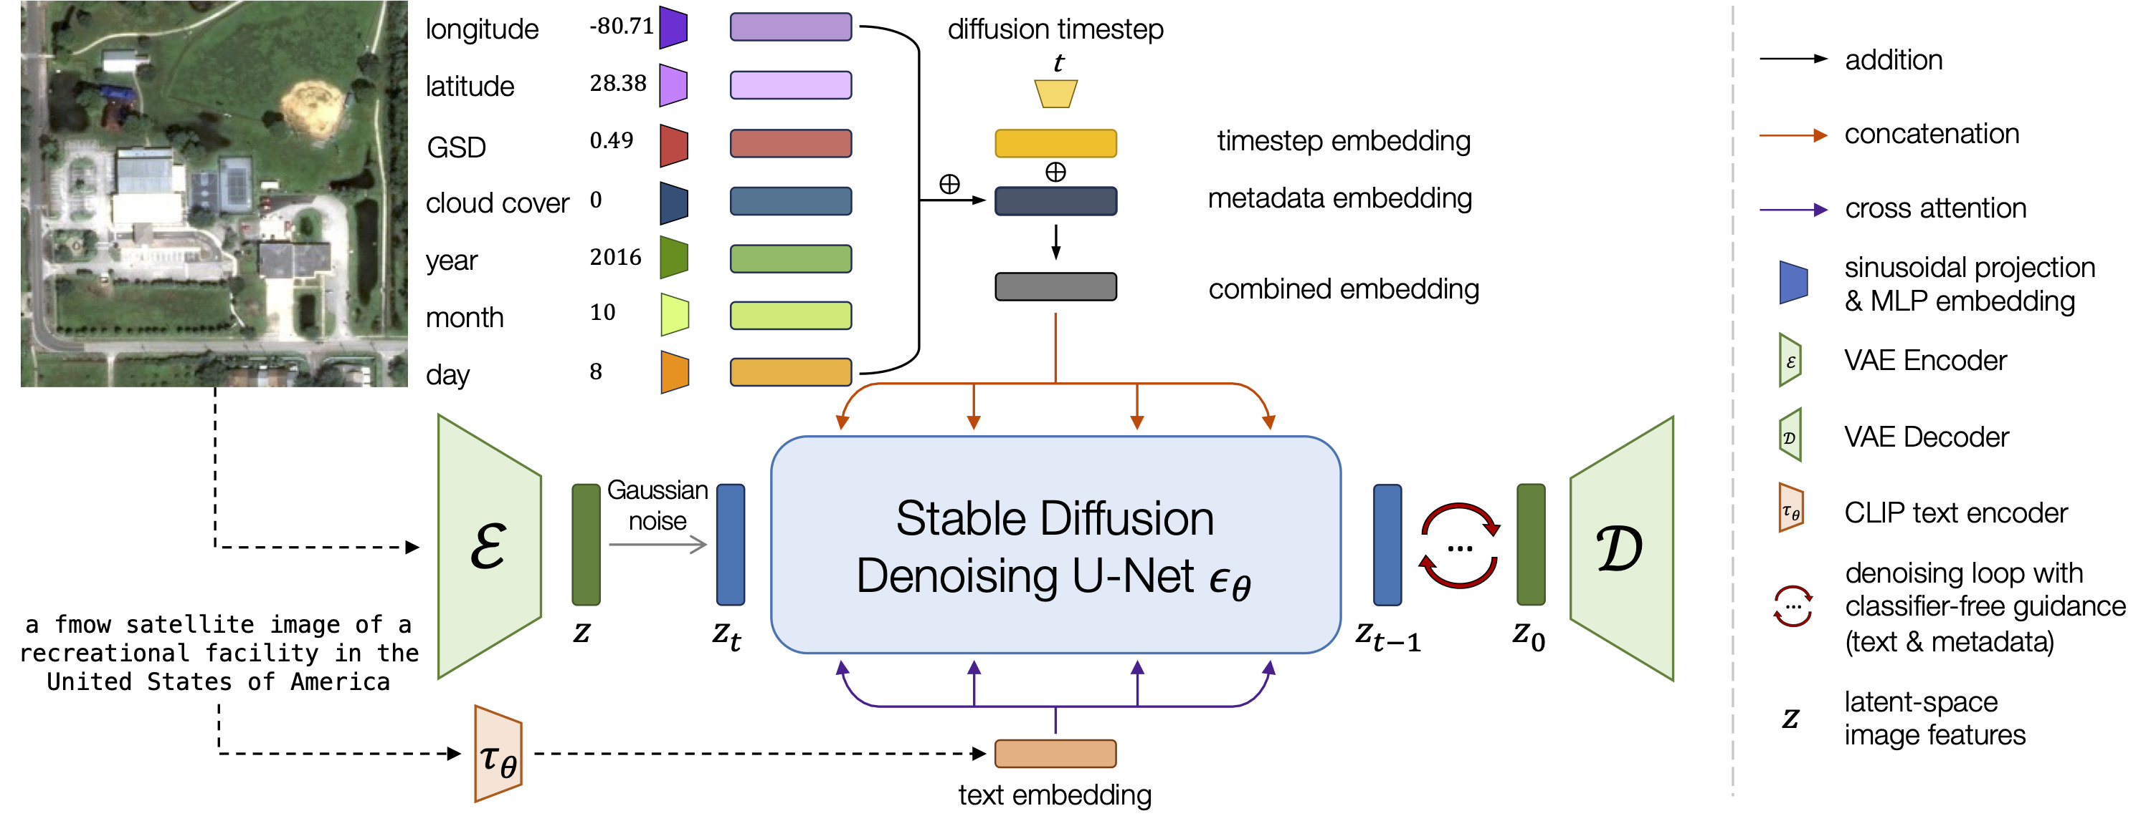
SD: Stable Diffusion for Satellite Image Generation
Core Component of DiffusionSat: Stable Diffusion based Image Generation Model.
© Sakura, 2024. All rights reserved.

Slide 21

SD + ControlNet: Conditional Image Generation
Architecture of DiffusionSat: Stable Diffusion (fine-tuning on SD 2.1) + ControlNet3D.
© Sakura, 2024. All rights reserved.

Slide 22
Single Image Generation
Textual Prompt + Numerical Metadata
© Sakura, 2024. All rights reserved.

Slide 23
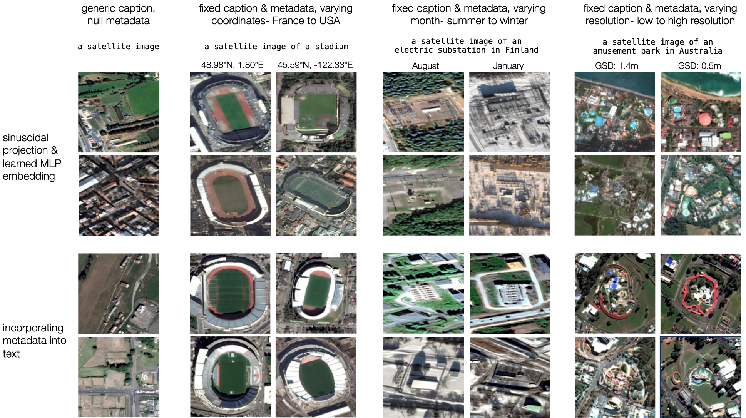
Textual Prompt + Numerical Metadata
Comparison of metadata in textual prompt . Above: using sinusoidal projection and MLP embedding (our method). Below: naïve in prompt as textual information.
© Sakura, 2024. All rights reserved.

Slide 24
Inverse Problems
Superresolution
Temporal Prediction
Temporal Inpainting
Temporal Sequence Generation
© Sakura, 2024. All rights reserved.

Slide 25
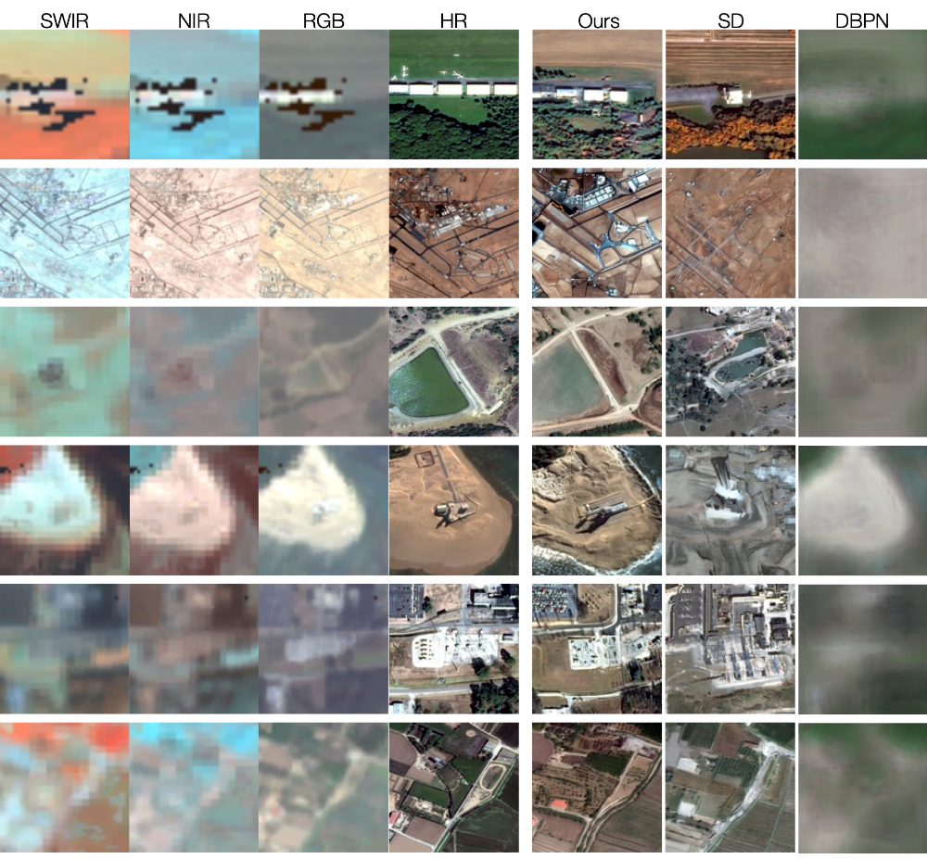
Superresolution
Method | FID↓ | IS↑ | CLIP↑
SD 2.1 | 117.74 | 6.42 | 17.23
SD 2.1 w/o metadata | 37.99 | 7.42 | 16.59
SD 2.1 w metadata | 24.23 | 7.60 | 18.62
Ours | 15.80 | 6.69 | 17.20
Method | SSIM↑ | PSNR↑ | LPIPS↓ | MSE↓
Pix2Pix | 0.1374 | 8.2722 | 0.6895 | 0.1492
DBPN | 0.1518 | 11.8568 | 0.6826 | 0.0680
SD | 0.1671 | 10.2417 | 0.6403 | 0.0962
SD + CN | 0.1626 | 10.0098 | 0.6506 | 0.1009
Ours | 0.1703 | 10.3924 | 0.6221 | 0.0928
Generated samples from fMoW-Sentinel superresolution validation set. The conditioning image is the Sentinel-2 multispectral (MS) image represented here as SWIR, NIR, RGB. The desired output is the high-resolution (HR) fMoW-RGB image. Our method is able to capture fine-grained details better than other baselines, even when the low-resolution MS image lacks detail. SD tends to “hallucinate" details.
© Sakura, 2024. All rights reserved.

Slide 26
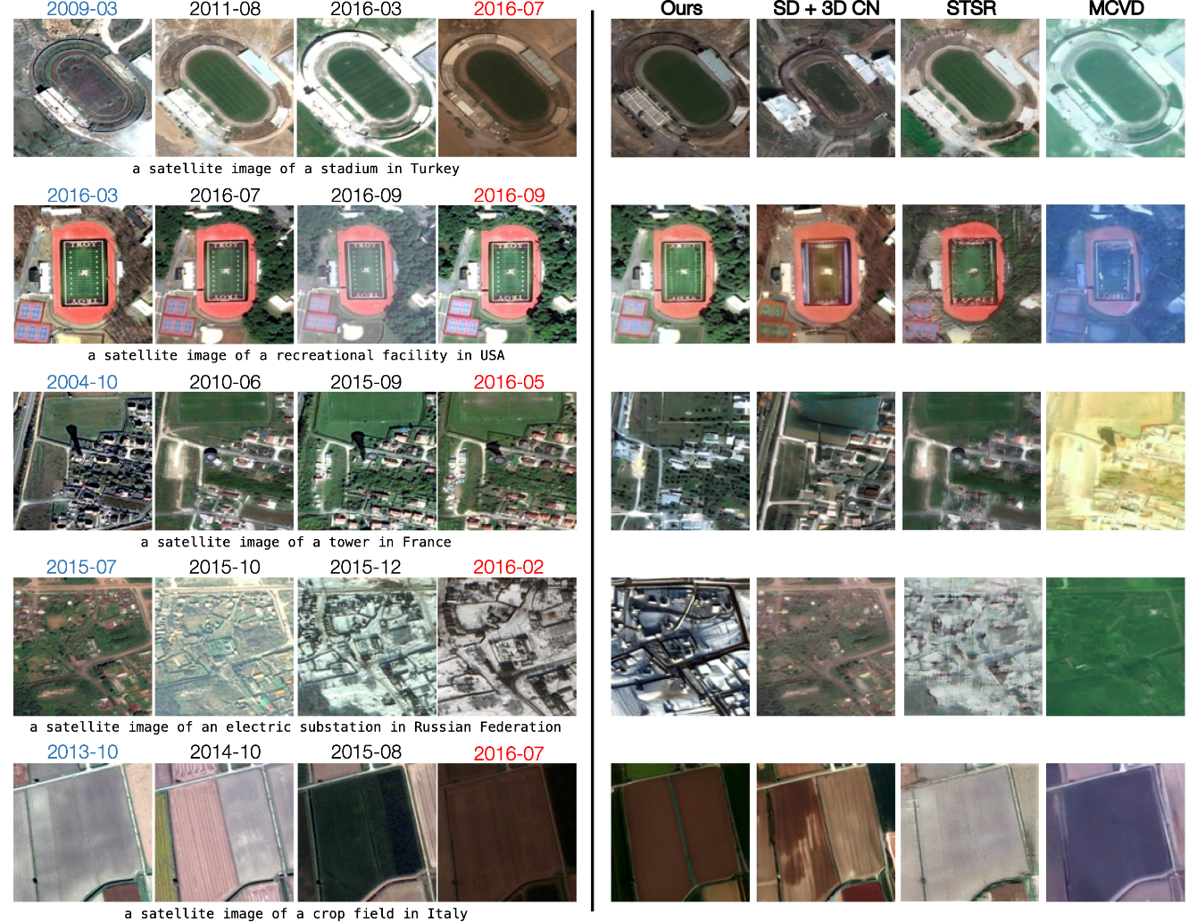
Temporal Prediction
Model | t′ > t
 | SSIM↑ | PSNR↑ | LPIPS↓
STSR (EAD) | 0.3657 | 13.5191 | 0.4898
MCVD | 0.3110 | 9.6330 | 0.6058
SD + 3D CN | 0.2027 | 11.0536 | 0.5523
DiffusionSat + CN | 0.3297 | 13.6938 | 0.5062
DiffusionSat + 3D CN | 0.3983 | 13.7886 | 0.4304
Generated samples from the fMoW-temporal validation set, for temporal prediction. The 4 columns in the center are ground-truth images from the temporal sequence. To the right, we see generated samples for the future-prediction task. The goal is to generate the image marked by the date in red, given the 3 other images (to its left) as conditioning signals.
© Sakura, 2024. All rights reserved.

Slide 27
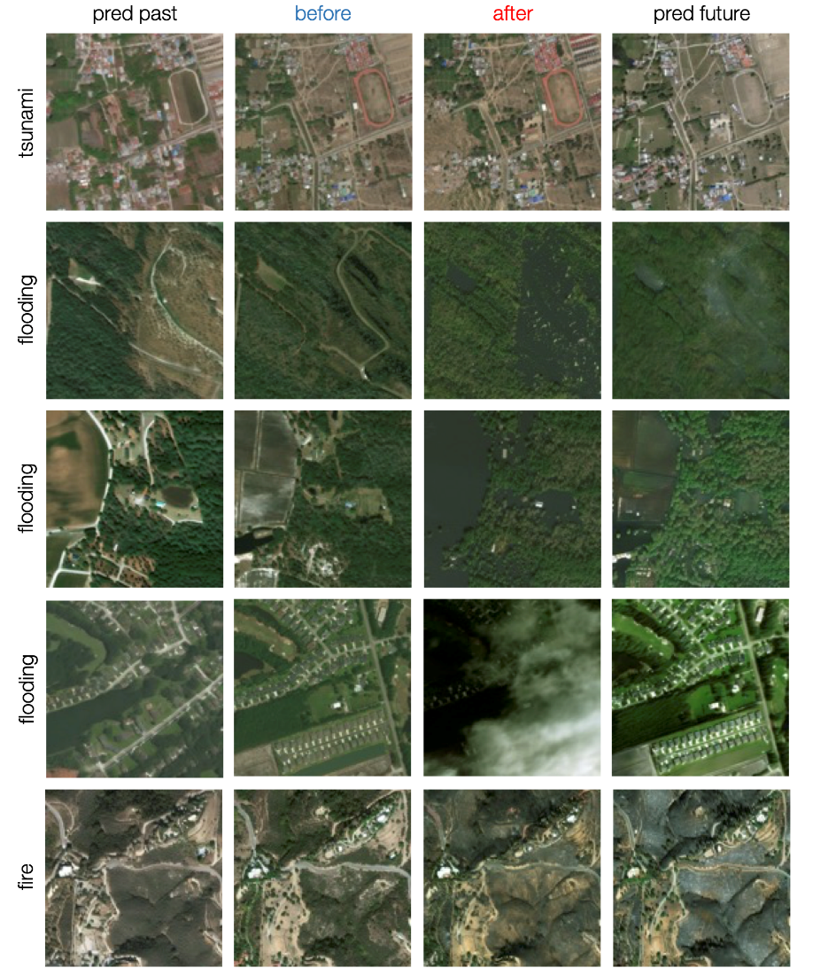
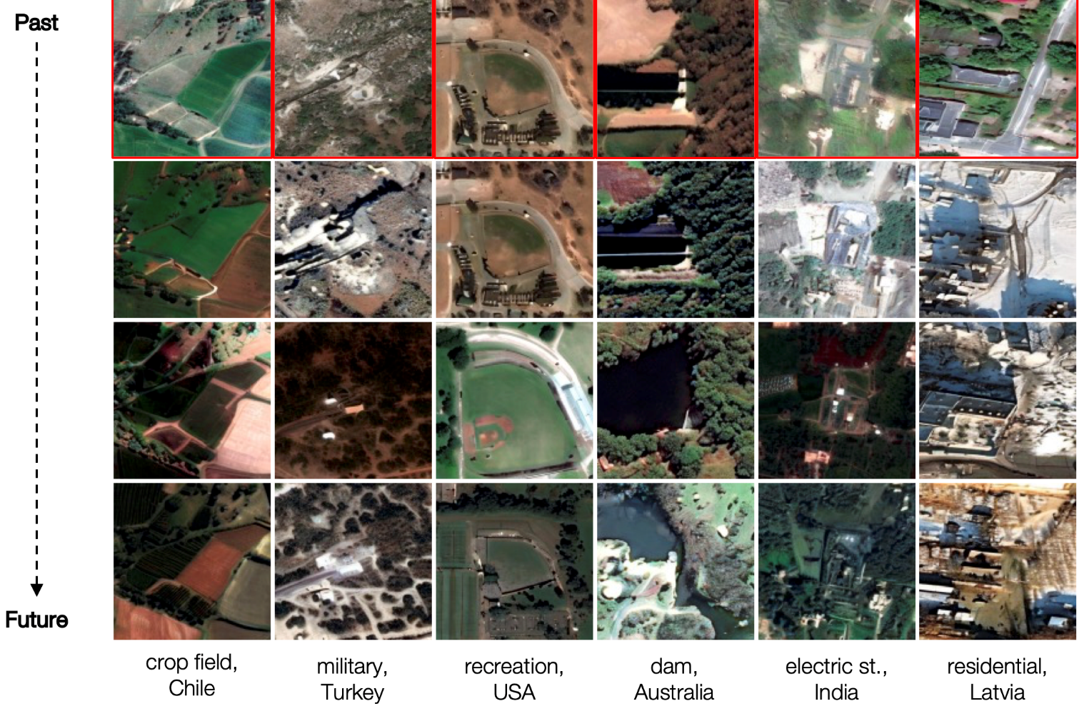
Temporal Inpainting & Temporal Sequence Generation
Temporal Inpainting
Temporal Sequence Generation
© Sakura, 2024. All rights reserved.

Slide 28
Practice on DiffusionSat Project:
- Let’s have a comprehensive understanding of DiffusionSat!
© Sakura, 2024. All rights reserved.

Slide 29
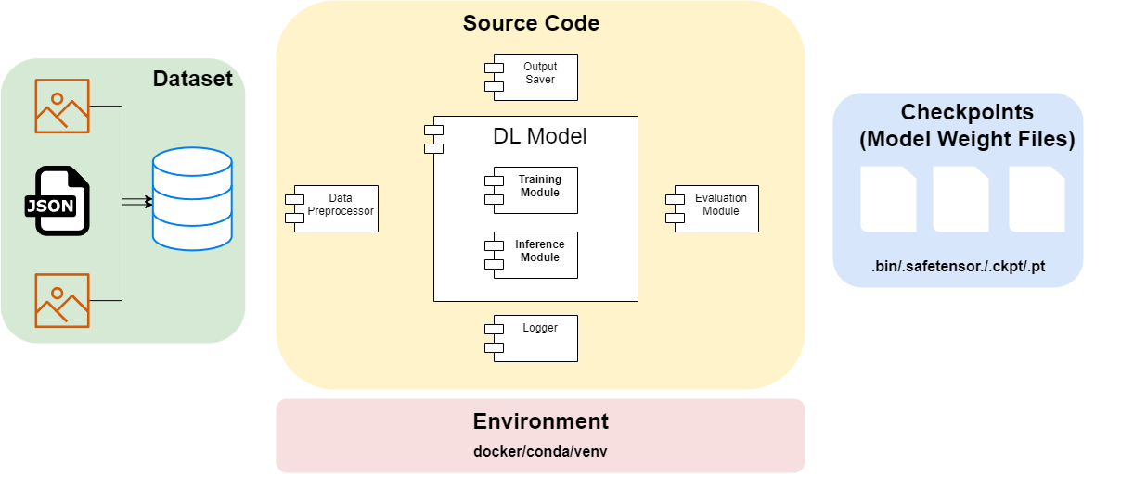
How a Python Project Structred?
Illustration of Common Python Project for Deep Learning.
© Sakura, 2024. All rights reserved.

Slide 30
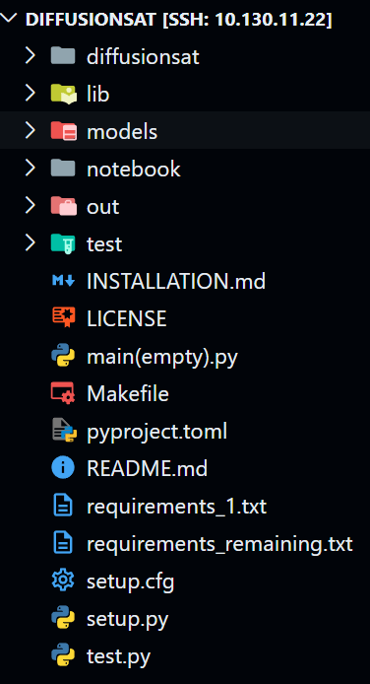
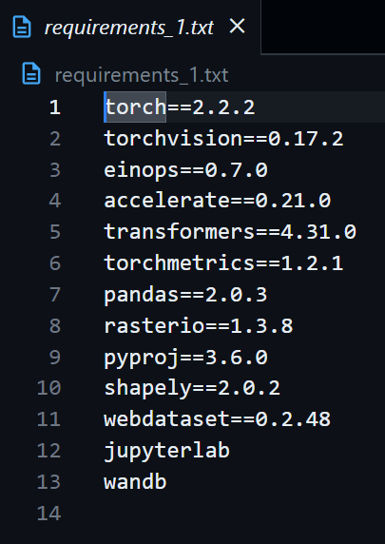
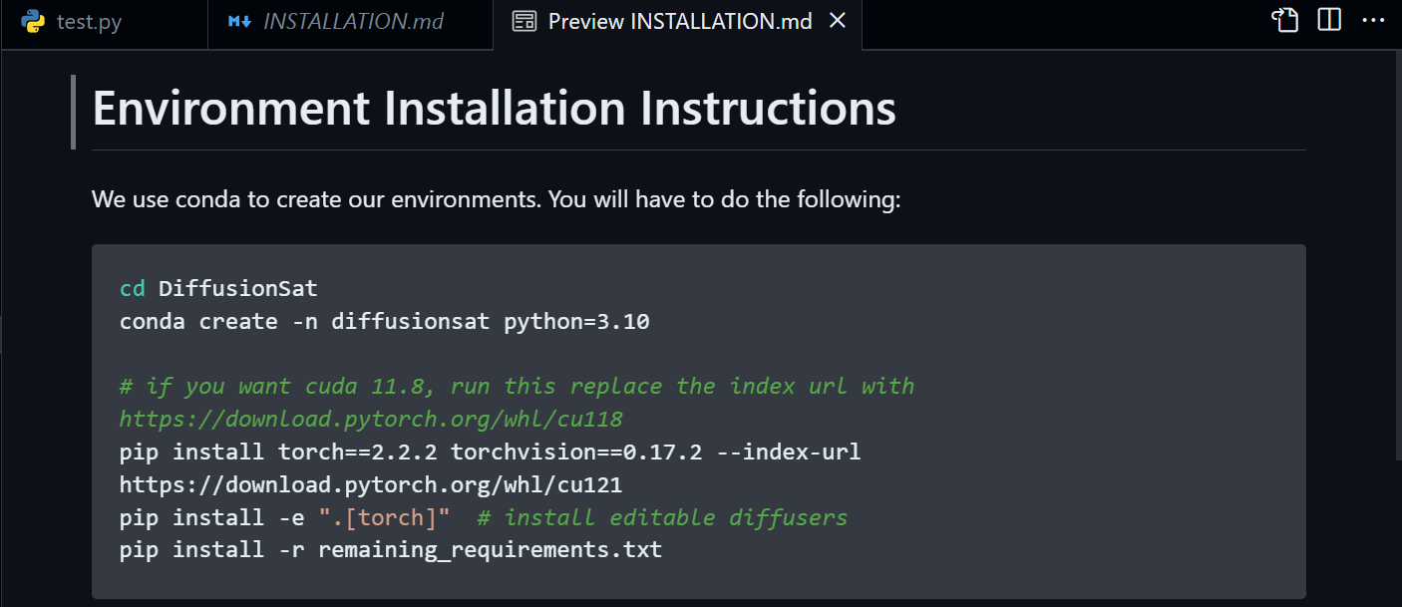
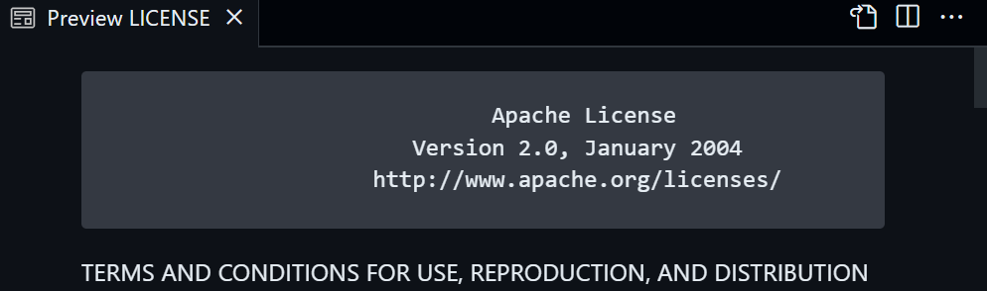
Decomposition of Project: take DiffusionSat as an example
Docs and Envs.
© Sakura, 2024. All rights reserved.

Slide 31
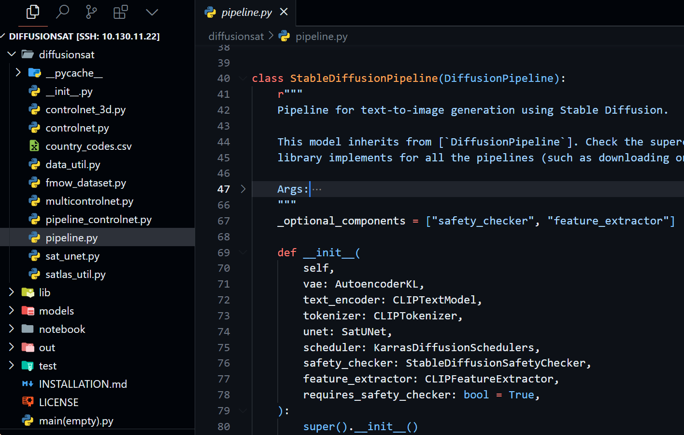
Decomposition of Project: take DiffusionSat as an example
Core of Source Code: Model Architecture Declaration and Component Classes.
© Sakura, 2024. All rights reserved.

Slide 32
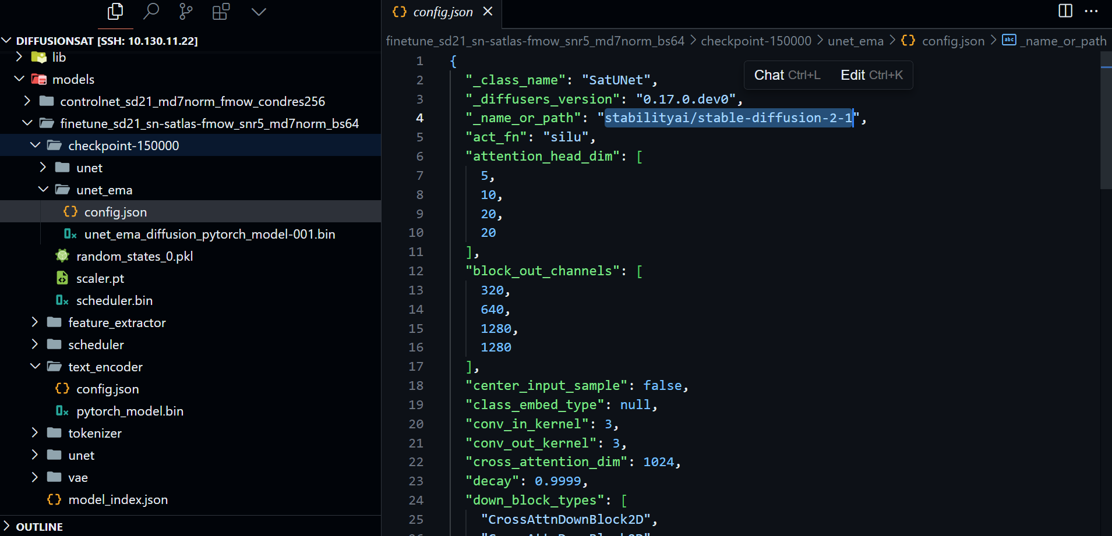
Decomposition of Project: take DiffusionSat as an example
Checkpoints.
© Sakura, 2024. All rights reserved.

Slide 33
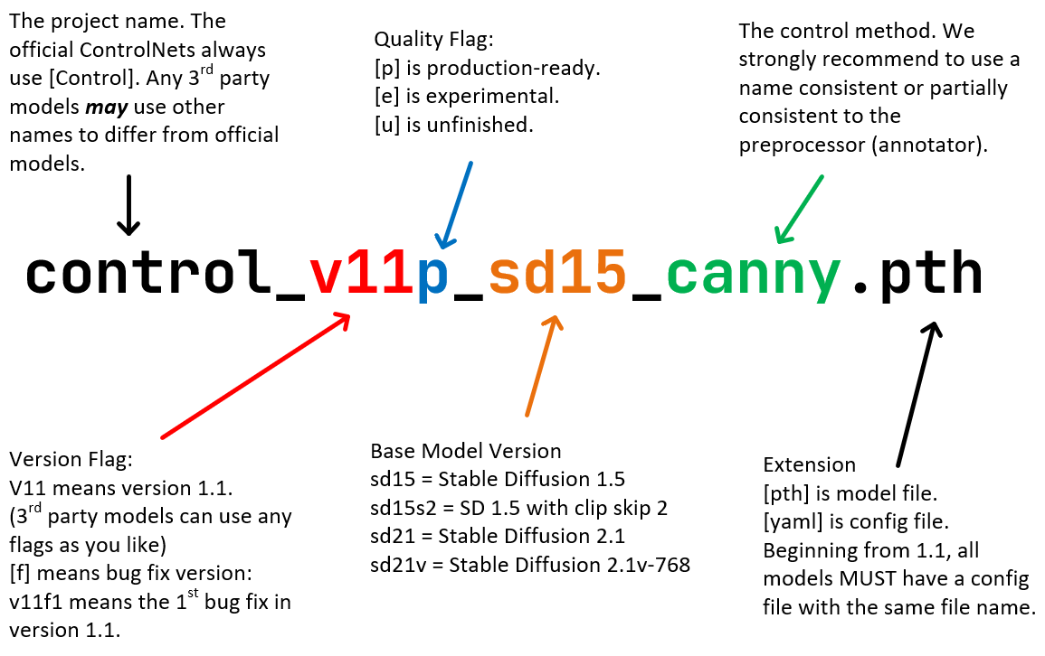
Others
Single Image Generation Model Checkpoint
finetune_sd21_sn-satlas-fmow_snr5_md7norm_bs64
finetune_sd21_256_sn-satlas-fmow_snr5_md7norm_bs64
Conditional Version Checkpoint
Superresolution(probably)
controlnet3d-mixattn_sd21_md7norm_texas
controlnet_sd21_md7norm_fmow_condres256
finetune: further train sd with satellite data
controlnet: conditioning training with 2d controlnet
controlnet3d: conditioning training with 3d controlnet
sd21: Stable Diffusion v2.1(same architecture with v1)
sn: SpaceNet dataset
satlas: Satlas dataset
fmow: fMoW dataset
texas: Texas Housing Dataset
snr5: Signal-to-Noise Ratio (SNR) = 5
md7norm: md7 normalization
bs64: batch size = 64
condres256:conditional resolution 256x256 pixels
Standard ControlNet Naming Rules (SCNNRs).
https://github.com/lllyasviel/ControlNet-v1-1-nightly?tab=readme-ov-file#model-specification
© Sakura, 2024. All rights reserved.

Slide 34
References and Related Works
[1] S. Khanna et al., ‘DiffusionSat: A Generative Foundation Model for Satellite Imagery’, in International Conference on Learning Representations, Dec. 2023. Accessed: Jul. 07, 2024. [Online]. Available: https://openreview.net/forum?id=I5webNFDgQ
[2] R. Rombach, A. Blattmann, D. Lorenz, P. Esser, and B. Ommer, “High-Resolution Image Synthesis With Latent Diffusion Models,” presented at the Proceedings of the IEEE/CVF Conference on Computer Vision and Pattern Recognition, 2022, pp. 10684–10695. Accessed: Jun. 29, 2024. [Online]. Available: https://openaccess.thecvf.com/content/CVPR2022/html/Rombach_High-Resolution_Image_Synthesis_With_Latent_Diffusion_Models_CVPR_2022_paper.html
[3] L. Zhang, A. Rao, and M. Agrawala, “Adding Conditional Control to Text-to-Image Diffusion Models,” in 2023 IEEE/CVF International Conference on Computer Vision (ICCV), Oct. 2023, pp. 3813–3824. doi: 10.1109/ICCV51070.2023.00355.
[4] D. Podell et al., “SDXL: Improving Latent Diffusion Models for High-Resolution Image Synthesis,” presented at the The Twelfth International Conference on Learning Representations, Oct. 2023. Accessed: Jul. 07, 2024. [Online]. Available: https://openreview.net/forum?id=di52zR8xgf
[5] P. Esser et al., “Scaling Rectified Flow Transformers for High-Resolution Image Synthesis,” presented at the Forty-first International Conference on Machine Learning, Jun. 2024. Accessed: Jul. 07, 2024. [Online]. Available: https://openreview.net/forum?id=FPnUhsQJ5B
© Sakura, 2024. All rights reserved.

Slide 35
Outline
Overview
Evolution of Stable Diffusion
Latent Diffusion Model (LDM)
Stable Diffusion
Stable Diffusion XL
Stable Diffusion 3
Quick Start with Stable Diffusion with Diffusers
Model Card
File Structures
Installation
Deployment
Further Explore Diffusers
© Sakura, 2024. All rights reserved.

Slide 36
Overview
© Sakura, 2024. All rights reserved.

Slide 37
Evolution of Stable Diffusion
© Sakura, 2024. All rights reserved.

Slide 38
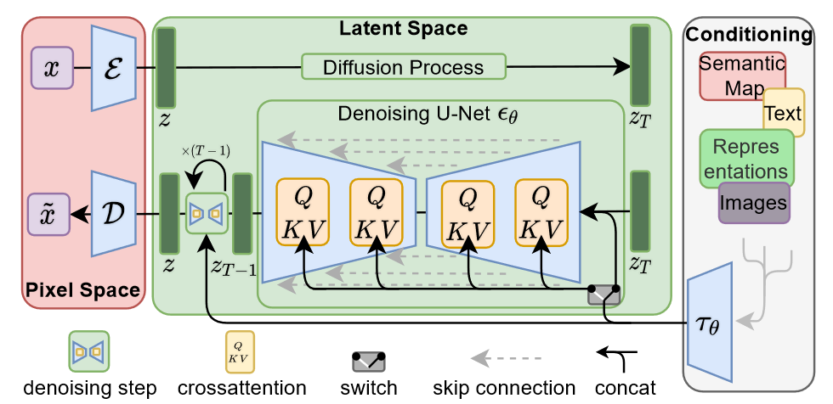
Latent Diffusion Model (LDM)
Architecture of LDM (Rombach et al., 2022)
Rombach, R., Blattmann, A., Lorenz, D., Esser, P., & Ommer, B. (2022). High-Resolution Image Synthesis With Latent Diffusion Models. 10684–10695.
© Sakura, 2024. All rights reserved.

Slide 39
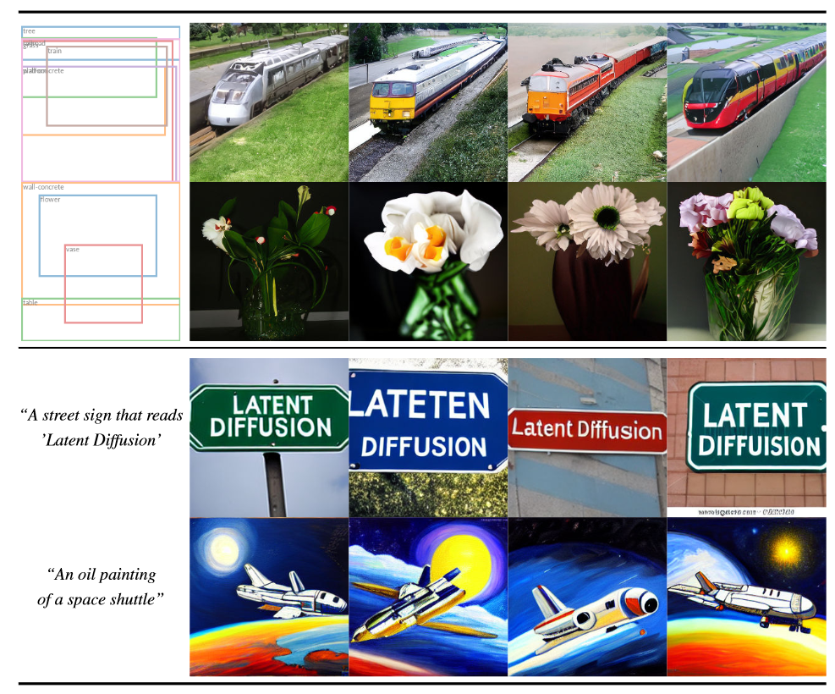
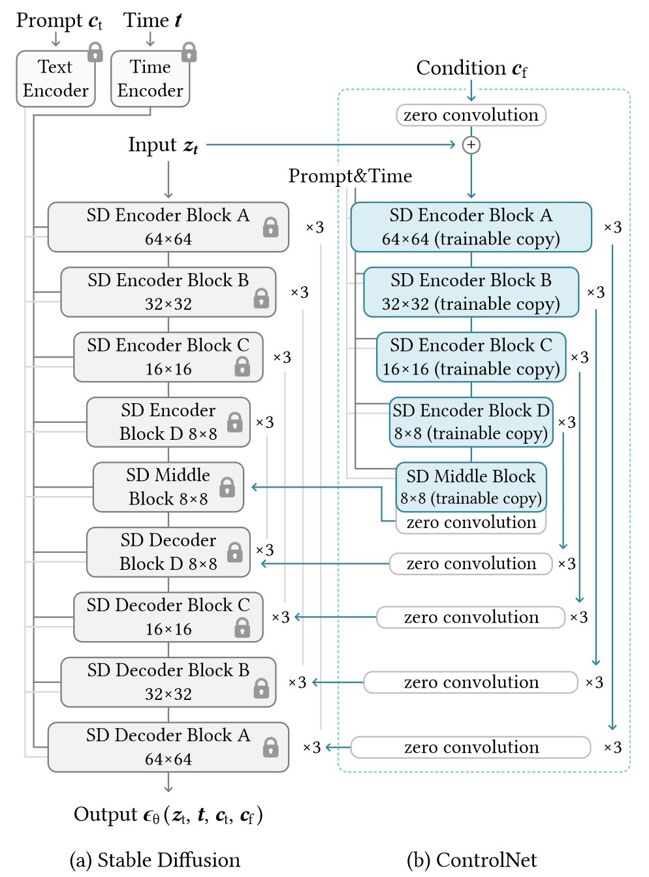
Latent Diffusion Model (LDM)
Top: Samples from our LDM for layout-to-image synthesis.
Bottom: Samples from our text-to-image LDM model for userdefined text prompts.
Architecture of Stable Diffusion (LDM)
with ControlNet(Zhang et al., 2023)
Rombach, R., Blattmann, A., Lorenz, D., Esser, P., & Ommer, B. (2022). High-Resolution Image Synthesis With Latent Diffusion Models. 10684–10695.
Zhang, L., Rao, A., & Agrawala, M. (2023). Adding Conditional Control to Text-to-Image Diffusion Models. 2023 IEEE/CVF International Conference on Computer Vision (ICCV), 3813–3824. https://doi.org/10.1109/ICCV51070.2023.00355
© Sakura, 2024. All rights reserved.

Slide 40
Stable Diffusion v1-v1.4
Owned by CompVis at the Ludwig Maximilian University of Munich
For the first version 4 model checkpoints are released. Higher versions have been trained for longer and are thus usually better in terms of image generation quality then lower versions. More specifically:
stable-diffusion-v1-1: The checkpoint is randomly initialized and has been trained on 237,000 steps at resolution 256x256 on laion2B-en. 194,000 steps at resolution 512x512 on laion-high-resolution (170M examples from LAION-5B with resolution >= 1024x1024).
stable-diffusion-v1-2: The checkpoint resumed training from stable-diffusion-v1-1. 515,000 steps at resolution 512x512 on "laion-improved-aesthetics" (a subset of laion2B-en, filtered to images with an original size >= 512x512, estimated aesthetics score > 5.0, and an estimated watermark probability < 0.5. The watermark estimate is from the LAION-5B metadata, the aesthetics score is estimated using an improved aesthetics estimator).
stable-diffusion-v1-3: The checkpoint resumed training from stable-diffusion-v1-2. 195,000 steps at resolution 512x512 on "laion-improved-aesthetics" and 10 % dropping of the text-conditioning to improve classifier-free guidance sampling
stable-diffusion-v1-4: The checkpoint resumed training from stable-diffusion-v1-2. 195,000 steps at resolution 512x512 on "laion-improved-aesthetics" and 10 % dropping of the text-conditioning to improve classifier-free guidance sampling.
stable-diffusion-v1-4 Resumed from stable-diffusion-v1-2.225,000 steps at resolution 512x512 on "laion-aesthetics v2 5+" and 10 % dropping of the text-conditioning to improve classifier-free guidance sampling.
Rombach, R., Blattmann, A., Lorenz, D., Esser, P., & Ommer, B. (2022). High-Resolution Image Synthesis With Latent Diffusion Models. 10684–10695.
© Sakura, 2024. All rights reserved.

Slide 41
Stable Diffusion v1.5
Owned by Runway
The Stable-Diffusion-v1-5 checkpoint was initialized with the weights of the Stable-Diffusion-v1-2 checkpoint and subsequently fine-tuned on 595k steps at resolution 512x512 on "laion-aesthetics v2 5+" and 10% dropping of the text-conditioning to improve classifier-free guidance sampling.
More Training Data
Better Text Encoder
Rombach, R., Blattmann, A., Lorenz, D., Esser, P., & Ommer, B. (2022). High-Resolution Image Synthesis With Latent Diffusion Models. 10684–10695.
© Sakura, 2024. All rights reserved.

Slide 42
Stable Diffusion v2.1
Owned by Stability AI
March 24, 2023 - Stable UnCLIP 2.1
New stable diffusion finetune (Stable unCLIP 2.1, Hugging Face) at 768x768 resolution, based on SD2.1-768. This model allows for image variations and mixing operations as described in Hierarchical Text-Conditional Image Generation with CLIP Latents, and, thanks to its modularity, can be combined with other models such as KARLO. Comes in two variants: Stable unCLIP-L and Stable unCLIP-H, which are conditioned on CLIP ViT-L and ViT-H image embeddings, respectively. Instructions are available here.
A public demo of SD-unCLIP is already available at clipdrop.co/stable-diffusion-reimagine
December 7, 2022 - Version 2.1
New stable diffusion model (Stable Diffusion 2.1-v, Hugging Face) at 768x768 resolution and (Stable Diffusion 2.1-base, HuggingFace) at 512x512 resolution, both based on the same number of parameters and architecture as 2.0 and fine-tuned on 2.0, on a less restrictive NSFW filtering of the LAION-5B dataset. Per default, the attention operation of the model is evaluated at full precision when xformers is not installed. To enable fp16 (which can cause numerical instabilities with the vanilla attention module on the v2.1 model) , run your script with ATTN_PRECISION=fp16 python <thescript.py>
November 24, 2022 - Version 2.0
New stable diffusion model (Stable Diffusion 2.0-v) at 768x768 resolution. Same number of parameters in the U-Net as 1.5, but uses OpenCLIP-ViT/H as the text encoder and is trained from scratch. SD 2.0-v is a so-called v-prediction model.
The above model is finetuned from SD 2.0-base, which was trained as a standard noise-prediction model on 512x512 images and is also made available.
Added a x4 upscaling latent text-guided diffusion model.
New depth-guided stable diffusion model, finetuned from SD 2.0-base. The model is conditioned on monocular depth estimates inferred via MiDaS and can be used for structure-preserving img2img and shape-conditional synthesis.
A text-guided inpainting model, finetuned from SD 2.0-base.
Rombach, R., Blattmann, A., Lorenz, D., Esser, P., & Ommer, B. (2022). High-Resolution Image Synthesis With Latent Diffusion Models. 10684–10695.
© Sakura, 2024. All rights reserved.

Slide 43
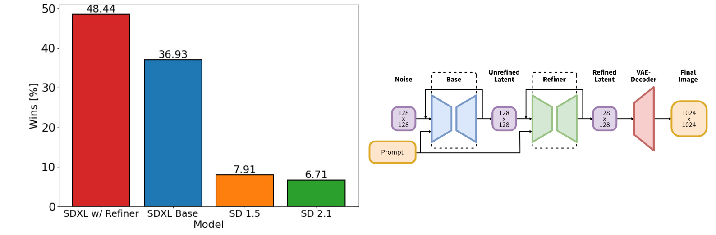
Stable Diffusion XL
Left: Comparing user preferences between SDXL and Stable Diffusion 1.5 & 2.1. While SDXL already clearly outperforms Stable Diffusion 1.5 & 2.1, adding the additional refinement stage boosts performance. Right: Visualization of the two-stage pipeline: We generate initial latents of size 128 × 128 using SDXL. Afterwards, we utilize a specialized high-resolution refinement model and apply SDEdit on the latents generated in the first step, using the same prompt. SDXL and the refinement model use the same autoencoder (Podell et al., 2023).
Podell, D., English, Z., Lacey, K., Blattmann, A., Dockhorn, T., Müller, J., Penna, J., & Rombach, R. (2023, October 13). SDXL: Improving Latent Diffusion Models for High-Resolution Image Synthesis. The Twelfth International Conference on Learning Representations.
© Sakura, 2024. All rights reserved.

Slide 44
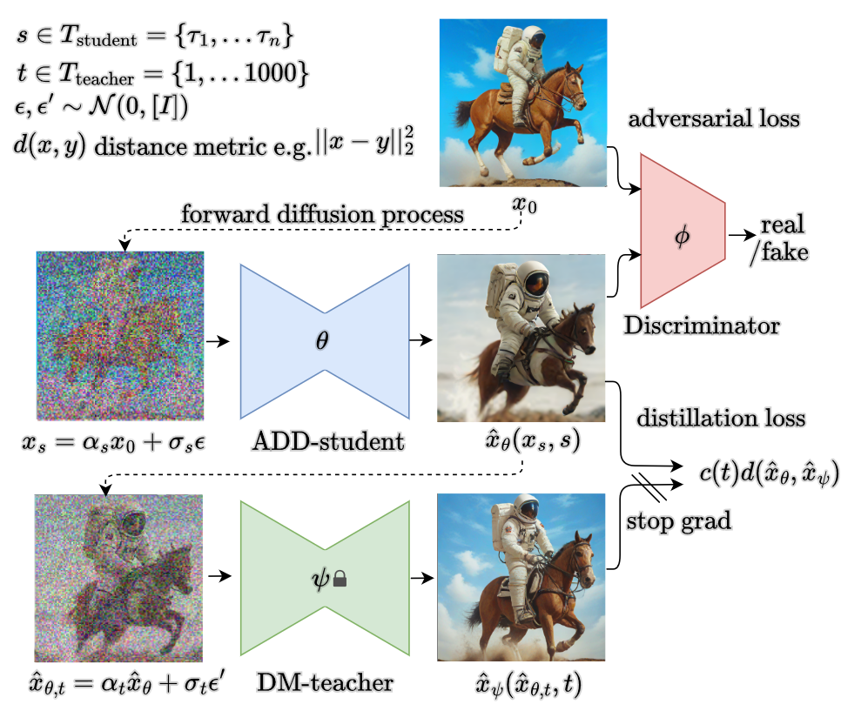
Stable Diffusion XL Turbo
Adversarial Diffusion Distillation (ADD). The ADD-student is trained as a denoiser that receives diffused input images $x_{s}$​ and outputs sample ${\hat{x}}_{θ}\left(x_{s}, s\right)$ , optimizing two objectives: a) Adversarial loss: The model aims to fool a discriminator trained to distinguish the generated samples $x_{θ}$from real images $x_{0}$. b) Distillation loss: The model is trained to match the denoised targets ${\hat{x}}_{ψ}$ of a frozen DM teacher (Sauer et al., 2023).
Sauer, A., Lorenz, D., Blattmann, A., & Rombach, R. (2023). Adversarial Diffusion Distillation (arXiv:2311.17042).
© Sakura, 2024. All rights reserved.

Slide 45
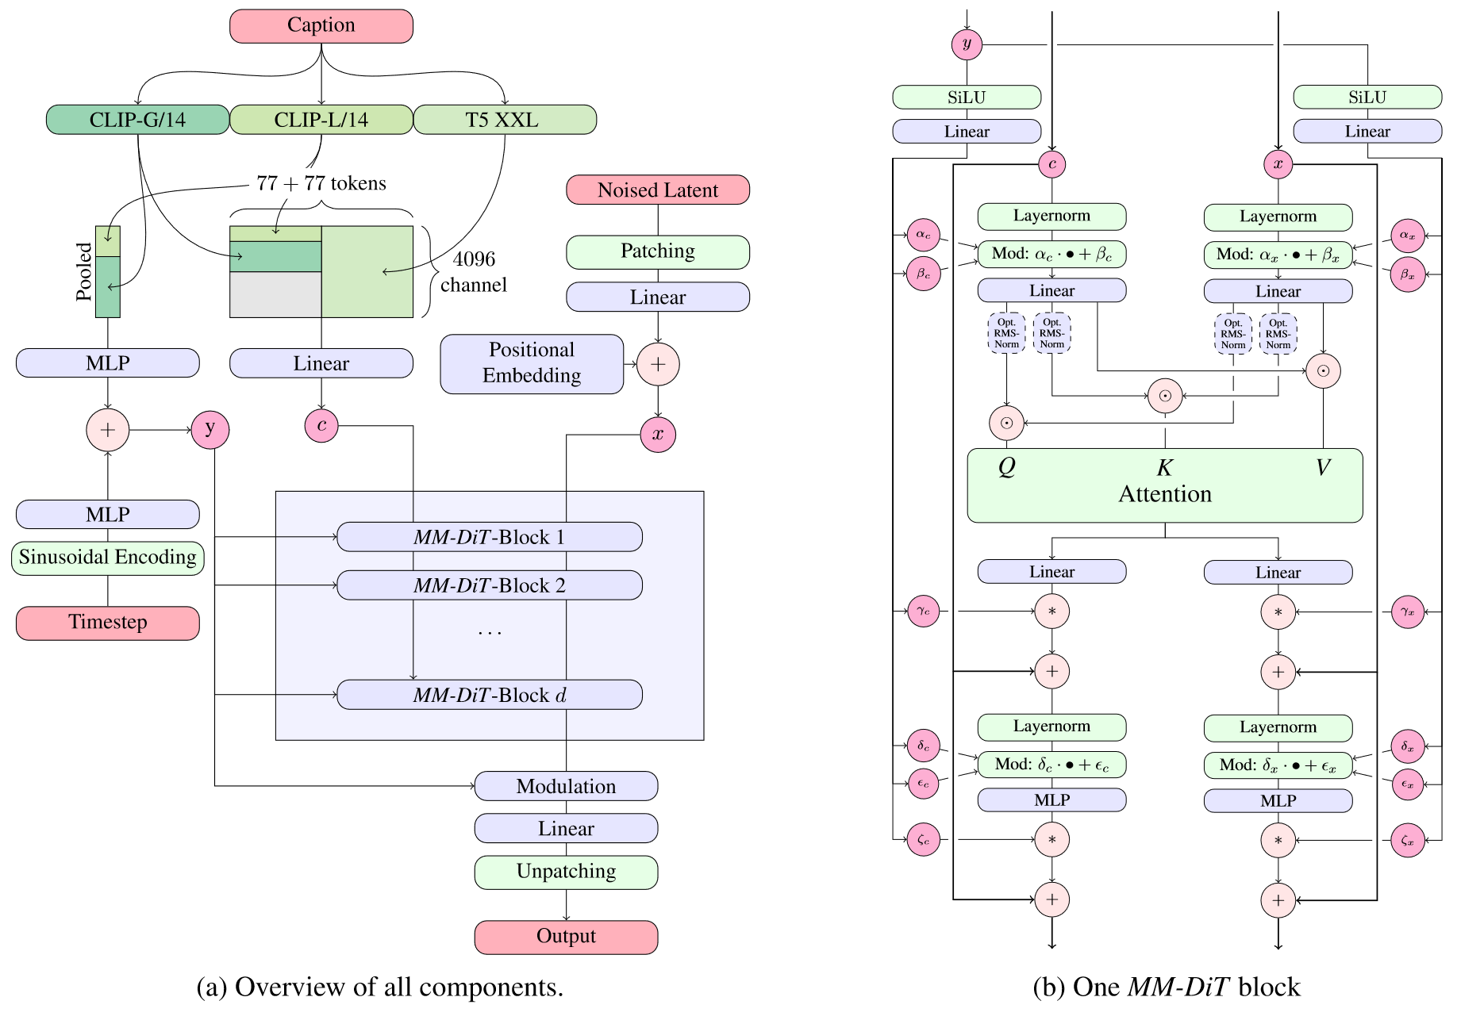
Stable Diffusion 3
Our model architecture. Concatenation is indicated by ⊙ and element-wise multiplication by ∗.
The RMS-Norm for Q and K can be added to stabilize training runs. Best viewed zoomed in (Esser et al. 2024).
Esser, P., Kulal, S., Blattmann, A., Entezari, R., Müller, J., Saini, H., Levi, Y., Lorenz, D., Sauer, A., Boesel, F., Podell, D., Dockhorn, T., English, Z., & Rombach, R. (2024, June 6). Scaling Rectified Flow Transformers for High-Resolution Image Synthesis. Forty-first International Conference on Machine Learning.
© Sakura, 2024. All rights reserved.

Slide 46
Quick Start with Stable Diffusion with Diffusers
© Sakura, 2024. All rights reserved.

Slide 47
Model Card – SD v2.1
@InProceedings{Rombach_2022_CVPR,
author = {Rombach, Robin and Blattmann, Andreas and Lorenz, Dominik and Esser, Patrick and Ommer, Bj\"orn},
title = {High-Resolution Image Synthesis With Latent Diffusion Models},
booktitle = {Proceedings of the IEEE/CVF Conference on Computer Vision and Pattern Recognition (CVPR)},
month = {June},
year = {2022},
pages = {10684-10695}
}
Model Details
Developed by: Robin Rombach, Patrick Esser
Model type: Diffusion-based text-to-image generation model
Language(s): English
License: CreativeML Open RAIL++-M License
Model Description: This is a model that can be used to generate and modify images based on text prompts. It is a Latent Diffusion Model that uses a fixed, pretrained text encoder (OpenCLIP-ViT/H).
Resources for more information: GitHub Repository.
Model Card (part of full version) of Stable Diffusion v2-1 (Rombach et al., 2022).
Rombach, R., Blattmann, A., Lorenz, D., Esser, P., & Ommer, B. (2022). High-Resolution Image Synthesis With Latent Diffusion Models. 10684–10695.
© Sakura, 2024. All rights reserved.

Slide 48
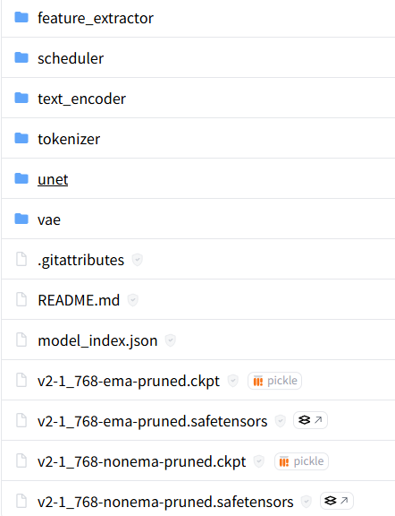
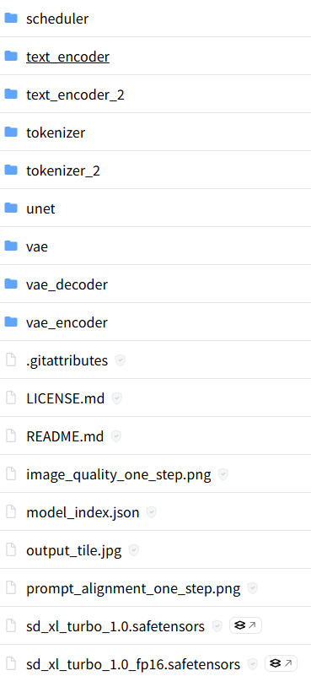
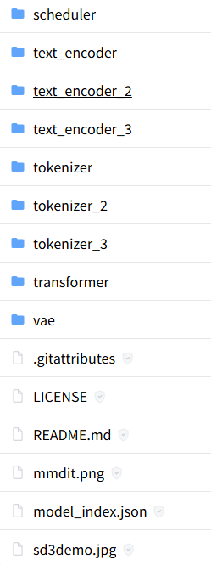
File Structures
From left to right: SD v2.1 (v1-v1.4, v2), SD XL Turbo (XL-base,…) and SD 3
https://huggingface.co/stabilityai/
© Sakura, 2024. All rights reserved.

Slide 49
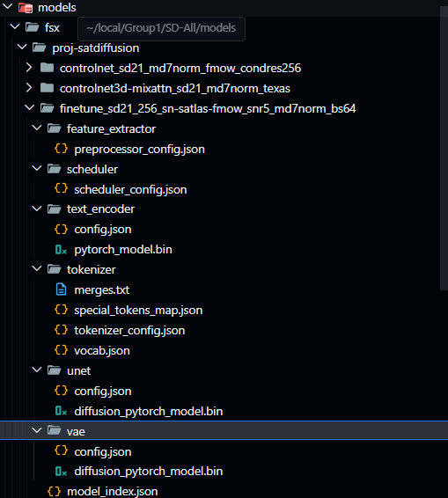
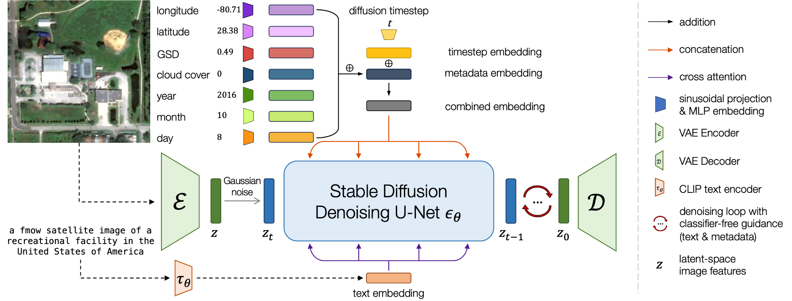
File Structure
DiffusionSat (Khanna et al., 2023)
Khanna, S., Liu, P., Zhou, L., Meng, C., Rombach, R., Burke, M., Lobell, D. B., & Ermon, S. (2023, October 13). DiffusionSat: A Generative Foundation Model for Satellite Imagery. The Twelfth International Conference on Learning Representations. https://openreview.net/forum?id=I5webNFDgQ
© Sakura, 2024. All rights reserved.

Slide 50
References and Related Works
Esser, P., Kulal, S., Blattmann, A., Entezari, R., Müller, J., Saini, H., Levi, Y., Lorenz, D., Sauer, A., Boesel, F., Podell, D., Dockhorn, T., English, Z., & Rombach, R. (2024, June 6). Scaling Rectified Flow Transformers for High-Resolution Image Synthesis. Forty-first International Conference on Machine Learning. https://openreview.net/forum?id=FPnUhsQJ5B
Podell, D., English, Z., Lacey, K., Blattmann, A., Dockhorn, T., Müller, J., Penna, J., & Rombach, R. (2023, October 13). SDXL: Improving Latent Diffusion Models for High-Resolution Image Synthesis. The Twelfth International Conference on Learning Representations. https://openreview.net/forum?id=di52zR8xgf
Rombach, R., Blattmann, A., Lorenz, D., Esser, P., & Ommer, B. (2022). High-Resolution Image Synthesis With Latent Diffusion Models. 10684–10695. https://openaccess.thecvf.com/content/CVPR2022/html/Rombach_High-Resolution_Image_Synthesis_With_Latent_Diffusion_Models_CVPR_2022_paper.html
Sauer, A., Lorenz, D., Blattmann, A., & Rombach, R. (2023). Adversarial Diffusion Distillation (arXiv:2311.17042). arXiv. https://doi.org/10.48550/arXiv.2311.17042
Zhang, L., Rao, A., & Agrawala, M. (2023). Adding Conditional Control to Text-to-Image Diffusion Models. 2023 IEEE/CVF International Conference on Computer Vision (ICCV), 3813–3824. https://doi.org/10.1109/ICCV51070.2023.00355
© Sakura, 2024. All rights reserved.

Slide 51


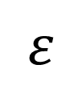
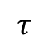
条件控制微调
合成数据集
trainable copy
pre-&post- image pairs
+
zero convolution
ControlNet
predicted image
数据处理与模型输入
Stable Diffusion
SOTA Models
$$ε$$
+
Segmentation
latent space
Scene Classification
conditioning image
①‘这张图展示了洪涝…’ ②（30°N，120°E）
$$τ$$
Change Detection
encoder
embedding
下游任务继续训练

